Slide 1
The French Revolution and Napoleon
1789-1815

Slide 2
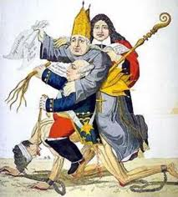
I. The Old Regime

Slide 3
A. Peasant Distress
1. Peasants comprised over four-fifths of France’s 26 million people
2. Peasants lost half their income in taxes. They paid feudal dues to nobles, tithes to the church and royal taxes to the kings agents. In addition, they paid a land tax called the taille and performed forced labor called the corvee.
3. Grain shortages led to sharp increases in the price of bread (major cause of discontent)

Slide 4
B. Government Debt
1. Louis XIV’s proligate spending left a massive public debt that consumed half the nation’s tax revenues.
2. The cost of fighting the Seven Years’ War and financing the American War for Independence worsened the fiscal crisis.

Slide 5
C. Aristocratic Resistance
1. French nobles were exempt from paying taxes.
2. The nobles successfully resisted all attempts to reform the tax system.

Slide 6
D. Royal Weakness
1. Louis XV (reigned 1715-1774) was a weak and indecisive ruler.
2. Louis XVI (reigned 1774-1792) and his Austrian wife Marie Antoinette were particularly unpopular and frivolous.
3. The high court of Paris – the Parliment- assumed the right to approve or disapprove the king’s decrees, thus further eroding royal power.

Slide 7
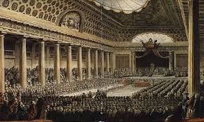
II. Estates General

Slide 8
A. Calling The Estates General
1. By the spring of 1789, the French government faced the imminent threat of bankruptcy.
2. The refusal of the Assembly of Notables to support Louis XVI’s program of tax reform forced the king to call a meeting of the Estates General.

Slide 9
B. The Three Estates
1. The first estate: the clergy
-The Catholic Church held about 20 percent of the land.
-The French clergy paid no direct taxes. Instead, they gave the government a ‘free gift’ of about 2% of their income
2. The second estate: the nobility
-Nobles comprised 2 to 4% of the population
-Nobles owned about 25% of the land

Slide 10
The Three Estates (con’t)
3. The third estate: everyone else
-the third estate comprised 95% of the population
-It included a diverse group of peasant farmers, urban workers, middle-class shopkeepers, wealthy merchants, and successful lawyers.
-those in their group resented aristocratic privileges.

Slide 11
C. The Tennis Court Oath, June 1789
1. Members of the first and second estates assumed that each estate would receive one vote. This system would enable them to impose their will on the third estate.
2. Led by Abbe Sieyes, the third estate rejected this method of voting and demanded that all three estates meet together.
3. When the ding refused, the third estate declared itself the true National Assembly of France.

Slide 12
Locked out of their official meeting place, the third estate met in a nearby indoor tennis court where they took an oath not to disband until they drafted a written constitution.
4. The Tennis Court Oath marked the beginning of the French Revolution.

Slide 13
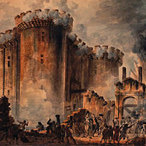
III. The National Assembly, 1789-1791

Slide 14
A. The Storming of Bastille
1. Determined to reassert royal authority, Louis XVI ordered a mercenary army of Swiss guards to march toward Paris and Versailles.
2. In Paris, angry mobs were already protesting the soaring price of bread. As tensions rose, a mob stormed the Bastille, a royal fortress and prison. The mob freed a handful of prisoners and seized the Bastille’s supply of gunpowder and weapons.

Slide 15
3. The fall of the Bastille marked an important symbolic act against royal despotism. It also pushed Paris to the forefront of the ongoing revolution.

Slide 16
B. The Declaration of the Rights of Man and the Citizen, August 1789
1. The declaration proclaimed that all men were ‘born and remain free and equal in rights’. These natural rights included the rights to ‘liberty, property, security, and resistance to oppression’.
2. The declaration provided for freedoms of religion, speech, arbitrary arrest, press and the right to petition the government.

Slide 17
C. The Rights of Women
1. Women gained increased rights to inherit property and to divorce.
2. Women did not gain the right to vote or to hold political office.
3. In her book, A Vindication of the Rights of Women, Mary Wolstonecraft argued that women are not naturally inferior to men. The appearance of inferiority is created by a lack of education.

Slide 18
D. Women’s March to Versailles, October 1789
1. On October 5, 1789, thousands of women marched to Versailles demanding cheap bread and insisting that the royal family move to Paris.
2. The king quickly capitulated, and a few days later the National Assembly also moved to Paris.

Slide 19
E. The Civil Constitution of the Clergy, August 1790
1. This act, passed by the National Assembly, did the following:
-confiscated the lands owned by the Roman Catholic Church
-Decreed that bishops and priests would be elected by the people and paid by the state
-Required the clergy to take a loyalty oath to support the new government
2. It is important to note that Pope Pius VI condemned the act and that over half of the clergy refused to take the oath of allegiance. Alienated Catholics proved to be persistent opponents of the French Revolution.

Slide 20
F. Reforms of the National Assembly
1. The National Assembly did
-create a constitutional monarchy
-divide France into 83 departments governed by elected officials
-establish the metric system of measurement
-abolish internal tariffs
-abolish guilds
2. The National Assembly did not
-abolish private property
-give women the right to vote

Slide 21
IV. The Legislative Assembly, 1791-1792

Slide 22
A. Factions in the Legislative Assembly
1. Members of the Legislative Assembly sat together in separate sections of the meeting hall. The political terms right, center and left are derived from the seating arrangement.
2. Conservatives who supported the king made up the Right.
3. Moderates comprised a large group in the Center.

Slide 23
4. Radicals who distrusted the ding and wanted the Revolution to continue sat to the left. The Left was divided into two groups:
-Jacobins wanted to overthrow the monarchy and create a republic. Key Jacobin leaders included Jean-Paul Marat, Georges-Jacques Danton, and Maximilien Robespierre.
-Girondists wanted to involve France in a war that would discredit the monarchy and extend France’s revolutionary ideals across Europe.

Slide 24
NOTE: It is important to remember that Lafayette was not a Jacobin, and that Girondists favored using war to spread French revolutionary ideals.

Slide 25
B. France Versus Austria and Prussia
1. Leopold of Austria and Frederick William II of Prussia issued the Declaration of Pillnitz (Aug. 1791) declaring that the restoration of absolutism in France was of ‘common interest to all sovereigns of Europe’.
2. The Legislative Assembly declared war against Austria and Prussia in April 1792, thus beginning the War of the First Coalition.
3. The war began badly for the poorly equipped French armies. By summer 1792, Austrian and Prussian armies were advancing towards Paris.

Slide 26
C. The Second French Revolution
1. Faced with defeat, recruits rushed to Paris singing the Marseillaise, a stirring appeal to save France from tyranny. The rejuvenated French forces stopped the Austro-Prussian army, thus saving the Revolution.
2. During the summer of 1792, radicals called sans-culottes (literally ‘without breeches’) took control of the Paris Commune (the City gov’t). The revolutionary Paris commune intimidated the Legislative Assembly into deposing Louis XVI and issuing a call for the election of a national convention. This new body would then form a more democratic government.

Slide 27
3. Violence once again exploded in Paris. Convinced that royalists would betray the Revolution, mobs of sans-culottes executed over a thousand priests, bourgeoisie, and aristocrats. These ‘September massacres’ marked the beginning of a second French Revolution dominated by radicals.

Slide 28
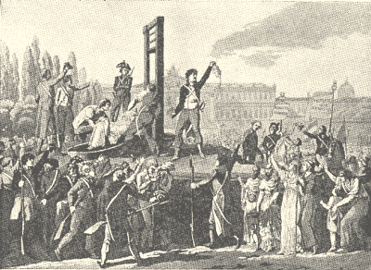
V. The National Convention, 1792-1795

Slide 29
A. The Execution of Louis XVI
1. The newly elected National Convention abolished the monarchy and declared that France was now a republic.
2. The National Convention then had to decide Louis XVI’s fate. The Girondists favored imprisonment while the Jacobins demanded that he be executed as a tyrant and a traitor.
3. After a contentious debate, the National convention passed a resolution condemning Louis XVI to death. The resolution passed by 1 vote!

Slide 30
4. Supported by the sans-culottes, the Jacobins branded the Girondins as counterrevolutionaries and ousted them from the National Convention.

Slide 31
B. European Reaction
1. At first, European liberals supported the French Revolution and applauded the fall of the Old Regime.
2. The English statesman Edmund Burke offered a conservative critique of the French Revolution. Burke warned that mob rule would lead to anarchy and ultimately military dictatorship. To many moderate Europeans, the Sept. massacres and the execution of Louis XVI vindicated Burke’s dire predictions.

Slide 32
C. Foreign and Domestic Threats
1. England, Spain, Holland and Sardinia joined Prussian and Austria to form the First Coalition. In the spring of 1793, First Coalition armies converged on France.
2. Internal strife also threatened the National Convention. Girondists and royalist Catholics rebelled against the tyranny of radical Jacobins.

Slide 33
D. The Reign of Terror
1. Faced with foreign invaders and the threat of domestic rebellion, the National Convention established the Committee of Public Safety to defend France and safeguard the Revolution.
2. Led by Robespierre, the Committee of Public Safety exercised dictatorial power as it carried out a Reign of Terror.
3. In the name of creating a Republic of Virtue, Robespierre executed the queen, his chief rivals, and thousands of ‘dangerous’ class enemies.

Slide 34
E. The ‘Nation in Arms’
1. While the Terror crushed domestic dissent, Robespierre turned to the danger posed by the First Coalition. In 1793, the Committee of Public Safety proclaimed a ‘levee en masse’ decreeing compulsory military service for all men between the ages of 18 and 40.
2. The levee en masse created a national military based upon mass participation. This marked the first example of the complete mobilization of a country for war.

Slide 35
3. Motivated by patriotism and led by corps of talented young officers that included Napoleon Bonaparte, France’s citizen-soldiers defeated the First Coalition’s professional armies.

Slide 36
F. The Thermidorian Reaction
1. The Committee of Public Safety successfully crushed internal dissent and defeated the First Coalition. Despite these victories, Robespierre continued to pursue his fanatical dream of creating a Republic of Virtue.
2. Fearing for their lives and yearning for stability, the National Convention reasserted its authority by executing Robespierre.

Slide 37
3. Robespierre’s death ended the radical phase of the French Revolution. On the new revolutionary calendar, July was called Thermidor from the French word for ‘heat’. Hence, the revolt against Robespierre is called the Thermidorian reaction.

Slide 38
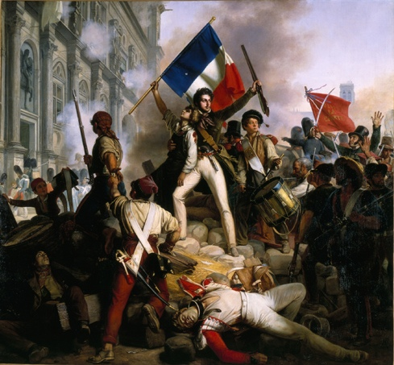
VI. The Directory , 1795-1799

Slide 39
A. Bourgeoisie Misrule
1. The government consisted of a two-house legislature and an executive body of five men known as the Directory.
2. Dominated by rich bourgeoisie, the Directory proved to be corrupt and unpopular.

Slide 40
B. The Fall of the Directory
1. Public discontent mounted as the Directory failed to deal with inflation, food shortages and corruption.
2. On November 9, 1799, an ambitious and talented young general named Napoleon Bonaparte overthrew the Directory and seized power.

