Slide 1
Social 30-2 chapter 13
S0 3.6 examine why government practices may not reflect values of liberalism (Canada)

Slide 2
In What Ways do the actions of Canada’s government reflect or go against liberal values?

Slide 3
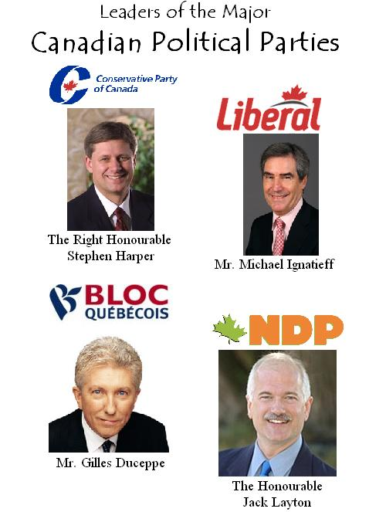
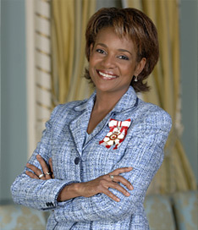
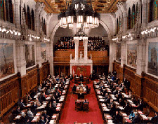
Liberal Democracy in Canada
Canada’s political system, widely accepted as being democratic and reflecting the values of liberalism, has also been criticized for not being as democratic as it could be.
We will look at 3 areas of Canadian gov’t that sometimes are criticized for not reflecting liberal principles.

Slide 4
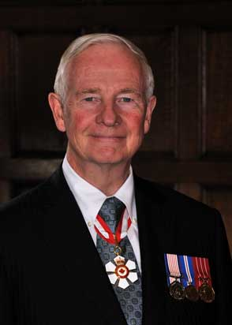
CANADA’S CURRENT GG – DAVID JOHNSTON

Slide 5
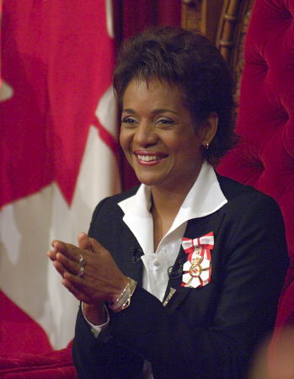
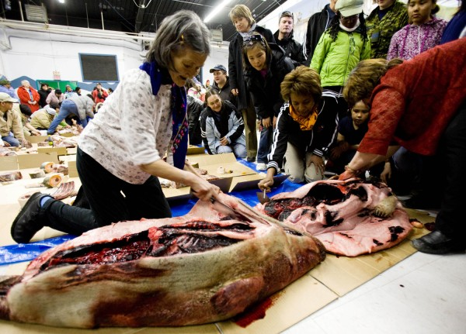
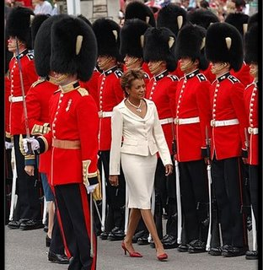
The Governor General and Lieutenant-Governors...
Michaelle Jean was appointed governor general by former prime minister Paul Martin.

Slide 6
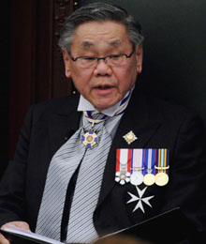
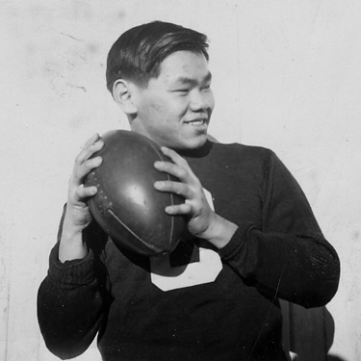
Norman Kwong
Alberta’s 16th lieutenant-governor in 2005.
(essentially the same role as the GG at a provincial level)

Slide 7
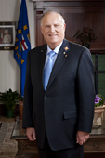
His Honour, Col. (Ret’d) the Honourable Donald S. Ethell was installed as the 17th Lieutenant Governor of Alberta on May 11, 2010

Slide 8
Governor General
The position dates back to 1608 when Samuel de Champlain was appointed to govern New France.
Canada is a parliamentary democracy and a constitutional monarchy – where we have an elected House of Commons, an appointed Senate, and a governor general.
Canada recognizes the queen as our head of state

Slide 9
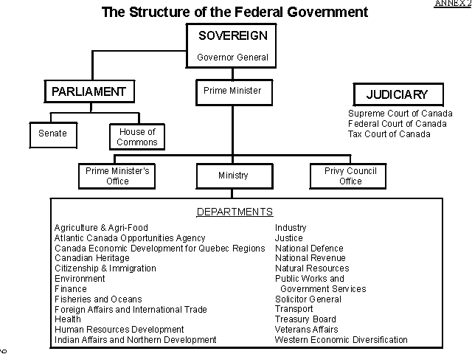

Slide 10
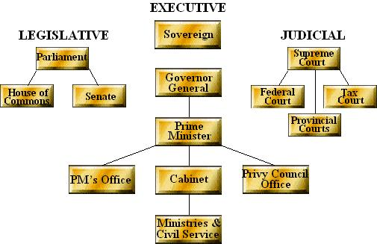

Slide 11
Governor General Duties
To Represent the Crown in Canada
To represent all Canadians and support our sovereignty:
To Celebrate excellence
To bring Canadians together.

Slide 12
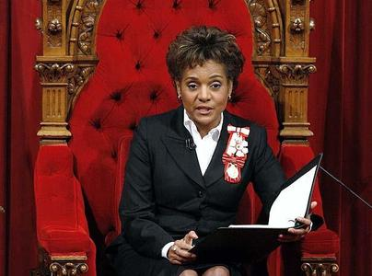
1. Represent the Crown
Guarantees that we have a prime minister and government in place (if PM died)
Appears in Parliament, signs official documents, and meets regularly with the prime minister to encourage, warn, and be consulted
Summons Parliament, reads the Speech from the Throne (sets out the governments program)
Gives Royal assent to bills that have
been passed by Parliament,
thus making the bills law

Slide 13
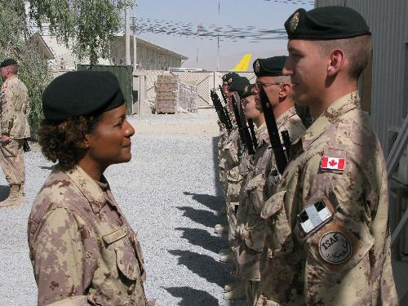
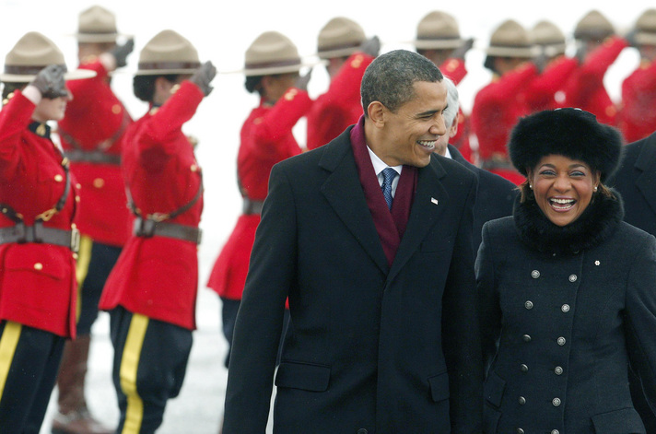
2. Represents all Canadians and support our sovereignty
Acts as Commander-in-chief of the Canadian Forces
Receives prominent guests and foreign leaders and leads delegations to other countries.

Slide 14
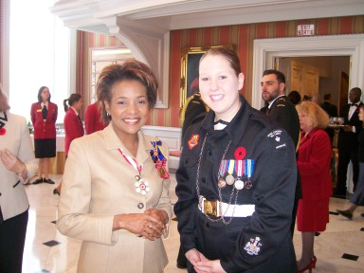
3. To Celebrate Excellence
Presents honours and awards (Order of Canada), decorations for bravery, awards for outstanding achievements (arts, social sciences, sports)

Slide 15
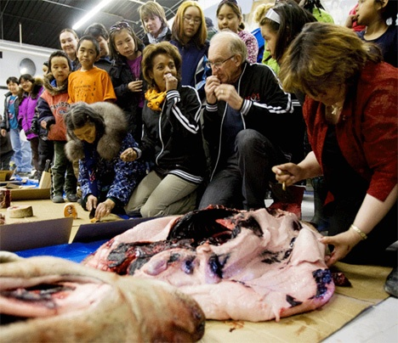
4. To Bring Canadians together
Promotes our national identity and unity
Meets with Canadians regularly, participates in community events and listens to concerns of Canadians.

Slide 16
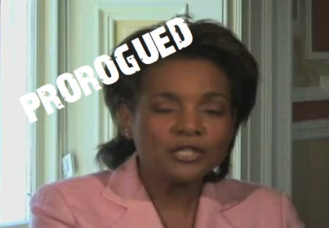
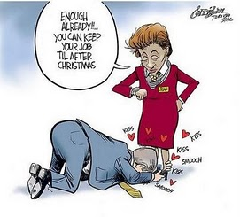
Other roles of the GG
Dissolve Parliament and call an election in the case of a non-confidence vote.

Slide 17
Criticisms of the GG’s office:
GG is appointed by the queen and chosen by the prime minister – no consultation with the public.
Governor General’s position is expensive to maintain
GG’s role is unnecessary and outdated

Slide 18
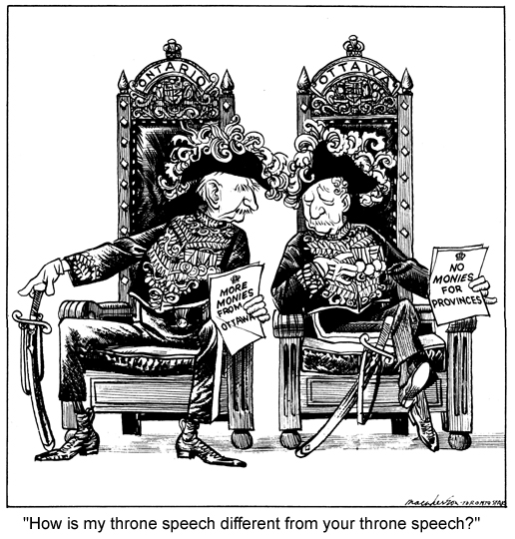
Think/Pair/Share...
Do you think that having an appointed governor general to represent a hereditary monarch is representative of liberal values?

Slide 19
The Senate
-created in 1867
-appointed upper house by the GG on the advice of the PM
-intended to represent regional and minority interests in Canada
-provides ‘sober second thought’ to bills
-once passed – bill goes for royal assent

Slide 20
Criticisms of the Senate
Senators are chosen from the PM not elected by the people, and they can stay until age 75
Senators do not always show up for sessions, and still get paid taxpayers’ money
They just vote the same way as the political party that nominated them

Slide 21
Senate Reform...
3 proposals for Senate Reform in Canada:
Election Vs. Appointment
Bill C-19
Bill C-20
Read page 344 (figure 13-7) to discuss the Positive and Negative results of Senate Reform

Slide 22
THINK/PAIR/SHARE
How might Senate reform address values of liberalism?
To what extent do the proposed Senate reforms reflect the values of liberalism?

Slide 23
The Tradition of Political Parties
The USA has a two party system (republicans, democrats).
Canada has a multi-party political system, where each party has a different platform

Slide 24
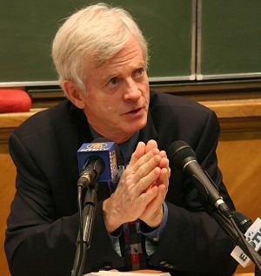
Aspects of Political Parties that may be contrary to liberal values:
Representatives must follow the ‘party line’ or platform – known as party solidarity. MP’s can object policy, but they must accept caucus decisions or he/she may be kicked out of the party. Some MP’s have ‘crossed the floor’ of the house of commons
David Kilgour – Edmonton mp who crossed the floor to the Liberals, and later became an independant. (opposed the gst)

Slide 25
Aspects of Political Parties that may be contrary to liberal values:
Majority governments can be somewhat dictatorial. If a party has a large majority, it may not worry about following the will of the people
Majority governments, in an attempt to stay in power, may not tackle important issues because they are always worried about not being able to continue governing
Lack of transparency – measure of how much the public knows about what the government is doing?

Slide 26
THINK/PAIR/SHARE
Think of the benefits political parties bring to a democracy. Do any of these benefits reflect liberal values.
If we did not have a multi-party system in Canada, what alternative system could better reflect liberal values?
How does government transparency relate to liberalism?

Slide 27
Chapter 13 – Enhancing Individual Rights and Collective Rights
So 3.7 explore the extent to which governments should promote individual and collective rights (Canadian Charter of Rights and Freedoms, Quebec Charter of Human Rights & Freedoms; First Nations, Metis and Inuit rights.

Slide 28
In What Ways can a democratic government enhance liberal values?

Slide 29
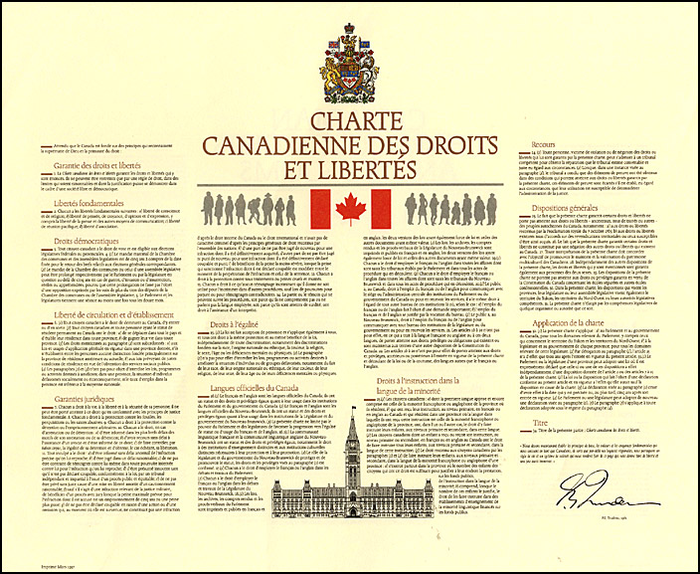
Liberal Values through Legislation
Unless there are laws in place to guarantee rights and freedoms, they may not be enjoyed by everyone.
In this section we will explore how government works to promote liberal values through legislation:

Slide 30
The Canadian Charter of Rights and Freedoms
Identifies guaranteed rights and freedoms for Canadians
Gives us the freedom to think and act in certain ways and the freedom from the abuses of power by governments.
Guarantees rights and freedoms to males and females and limits the ability of governments to pass laws or take actions that infringe on our civil rights

Slide 31
Rights have Limits...
You have the right to freedom of speech, but you do not have the right to make statements that promote hatred against a group of people.
You have the right to be protected against unreasonable search and seizure, but that does not give you the right to refuse to allow security officers to search your luggage before boarding an airplane

Slide 32
Rights have Limits...con’t
Federal, provincial and territorial governments also have some power in special circumstances to limit some individual rights using what is called the ‘notwithstanding clause’. (allows the government to pass a law that may override a part of the Charter for a limited time – up to 5 years.
Most of the rights in the charter are individual rights, however there are sections of the charter that outline collective rights (Canada’s official languages, minority language education rights, and rights of Aboriginal peoples.

Slide 33
Some Individual Rights in the Canadian Charter of Rights and Freedoms (sec 2-15) Page 349
Individual Rights | Summary
Fundamental Freedoms
Democratic Rights
Mobility Rights
Legal Rights
Equality Rights

Slide 34
Promoting Political & Economic Rights
Voting in Canada was not a guaranteed individual political right
Year | Who Was Given the right to Vote?
1916 | Manitoba allows women to vote (1st prov. In Canada)
1918 | Women in Federal Elections
1920 | Universal right except for minorities & Aboriginal people
1948 | Minorities
1955 | Doukhobours
1960 | First Nations
1988 | People with mental disabilities
1993 | Prisoners

Slide 35
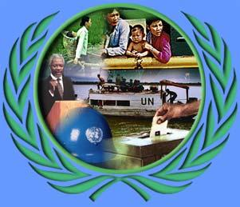
United Nations Universal Declaration of Human Rights
Some say the Canadian Charter of Rights and Freedoms does not go far enough
UN Universal Declaration of Human Rights promotes life free from poverty and the right to a job and a decent wage.
Canada has signed the UN Universal Declaration of Human Rights

Slide 36
Economic Rights in Quebec
1975 – Quebec modelled the UN Charter – the Quebec Charter acknowledged the economic rights of the people of Quebec
Quebec Charter promotes fundamental civil and political rights, and prevents discrimination on such grounds as race, gender, sexual orientation, age, religion, language.

Slide 37
Canada’s Multiculturalism Act
1988 – aims to preserve and enhance multiculturalism in Canada
Officially recognizes the importance of Canada’s multicultural heritage – preserve and promote.
Recognizes the rights of Aboriginals
Canadian citizens have equal rights, regardless of skin colour, religion, country of birth, ethnic background
Recognizes the rights of ethnic, linguistic, and religious minorities to keep their cultures, languages, and religious practices.

Slide 38
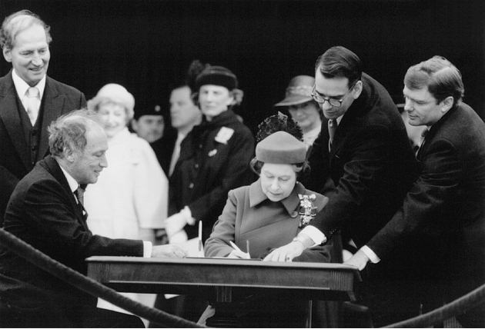
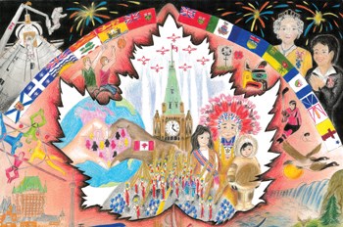
Canada’s Multiculturalism Act
1971 Trudeau first announced Canada would follow a policy of multiculturalism

Slide 39
Collective Rights in the Charter
Canada has been shaped by the contributions of people from many different cultures and groups
Canada has a strong commitment to pluralism (diversity of language, beliefs, traditions, values, religions)
Collective rights are based on historical agreements related to the development of Canada
In Canada the term collective rights refers to these legal rights for specific groups under the Charter .

Slide 40
Summary of Collective Rights
Collective Right | Summary
Official Language rights | Right to use English or French in all institutions of parliament and courts
Minority language education rights | Provision of schools and boards for children of Francophone and Anglophone parents in provinces where these official language groups form minority
Aboriginal rights (sec 25) | Do not take away from any aboriginal treaty or other rights of Aboriginals
Aboriginal rights (sec 35) | Land claims and treaty rights for male and female persons

Slide 41
Landmark Decisions of Aboriginal Rights - divide into 3 groups and report out
Case | Description of the case and ruling | To what extent did the court’s decision reflect modern liberal values?
Sparrow Case
Metis Harvesting Agreement
Supporting Inuit Rights

Slide 42
Collective Rights of Canada’s Official Language Groups
In addition to Aboriginal peoples, Francophone’s and Anglophones possess certain rights as a result of their historic foundations of Canada.
Eg. Manitoba Schools Act in 1890 –abolished French as an official language in Manitoba
Eg. Alberta allows Francophone school boards.
Eg. Charter also applies to the Anglophone minority in Quebec

