Slide 1
Rights, Roles and Responsibilities of Citizens
So 4.4 explore how ideologies shape individual and collective citizenship
So 4.5 examine perspective on the rights, roles and responsibilities of the individual in a democratic society (respect for law and order, protest, civil disobedience, political participation)
So 4.6 examine perspectives on the rights, roles and responsibilities of the individual during times of conflict ( humanitarian crises, antiwar movements, pro-democracy movements, contemporary examples)

Slide 2
Differing Ideologies...
People have different points of view about rights, roles and responsibilities as citizens.
This can be linked to many factors – ideological beliefs and values and personal experiences.

Slide 3
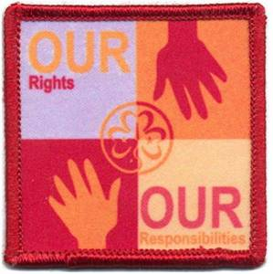
Rights, Roles and responsibilities of Citizens

Slide 4
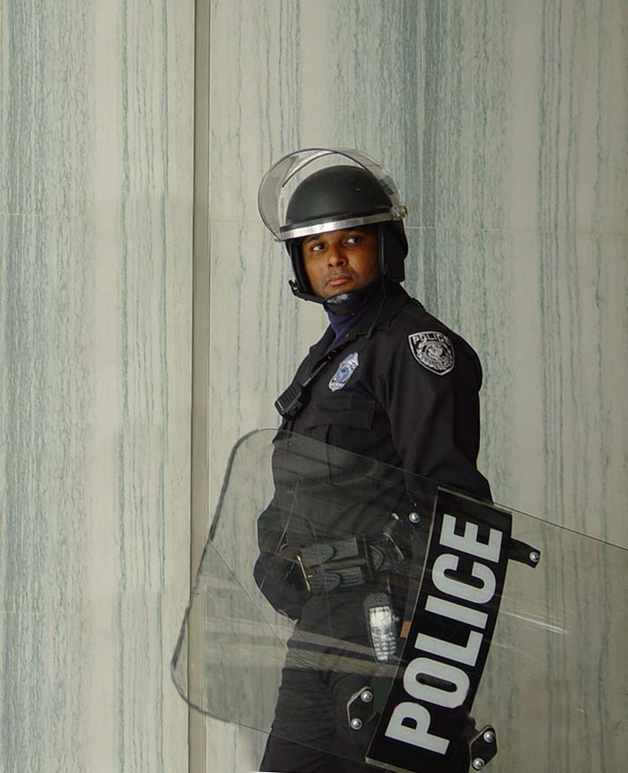
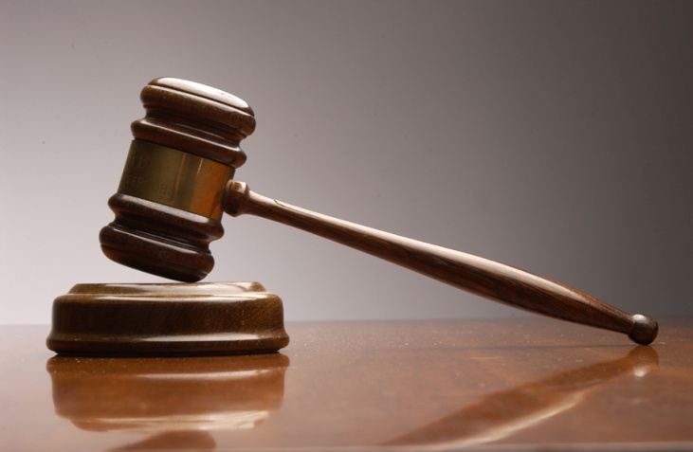
Respect for Law and Order
one responsibility of citizenship is to obey the laws of the community in which you live.
These laws are part of a contract we agree to follow as citizens of a community. Laws can be adapted from citizen feedback.
Justice system – police officers, judges, prosecutors, ensure the laws are followed.

Slide 5
More than just the responsibility to follow the laws....
COP – Citizens on Patrol – keeping communities safe
Guardian Angels – volunteers to enforce community laws.

Slide 6
Political Participation – Why & How
A desire on citizens to affect change may encourage citizens in a democratic country to participate in the political process.
Write a letter to your mayor, MLA, newspaper
Circulate a petition – school, community or online
Organize a rally to protest an issue
Take an issue to the Human Commission if your rights have been violated
Run for public office
Join or support a political party
VOTE!
Join an Interest Group (Amnesty International )

Slide 7
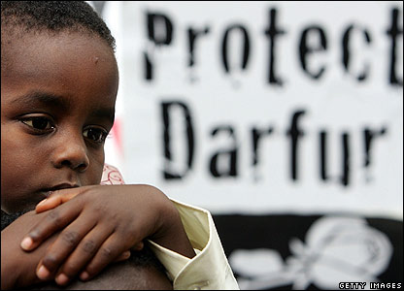
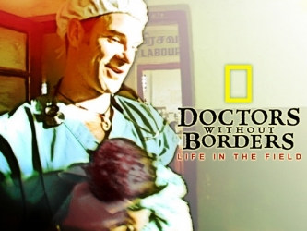
Humanitarianism
Crisis situations ( poverty, natural disasters, abuse) often influence citizens to interpret and act on their rights, roles and responsibilities.

Slide 8
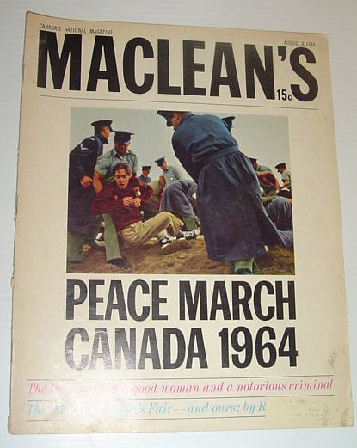
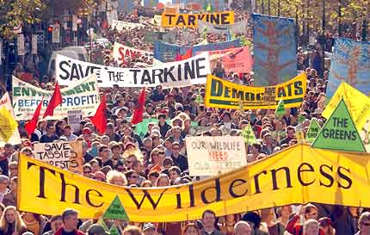
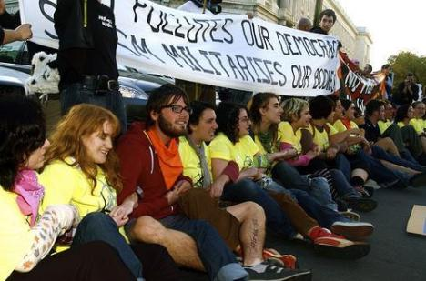
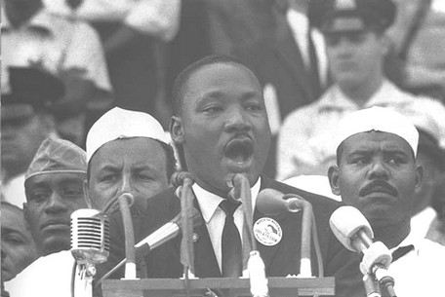
Protest and Civil Disobedience
The freedom to question the decisions made by our government is an important element of democracy.
When people feel their voices are not being heard, demonstrations or protests are often organized.
Civil disobedience – non-violent action taken against something perceived as unjust.

Slide 9
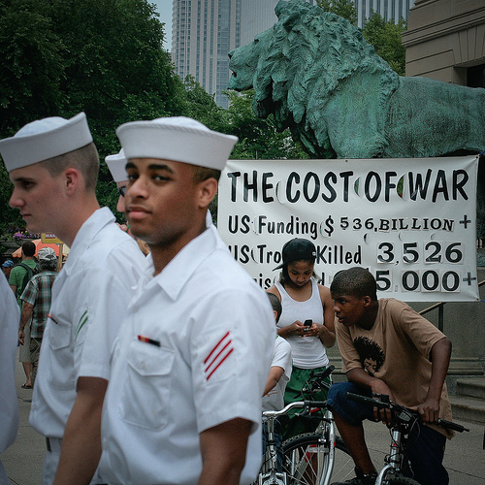
Citizens and Government during times of conflict

Slide 10
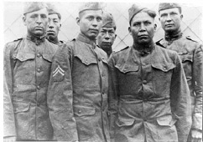
Citizenship and Aboriginal Participation in the First and Second World War
Sometimes, despite decisions made by their government, citizens as individuals or collectives, take action based on their ideological convictions.
In WWI & WWII, Aboriginal soldiers accepted the responsibilities of Canadian citizenship, even though the Canadian government had not granted them the rights of citizenship.

Slide 11
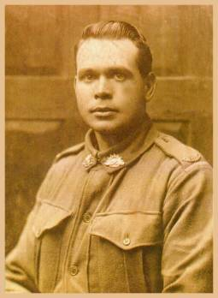
Aboriginal Participation...
1914 – many Aboriginal people were feeling betrayed by the Canadian Gov’t as a result of colonial policies of assimilation and discrimination
But Aboriginal people still
volunteered in large numbers
for the war effort

Slide 12
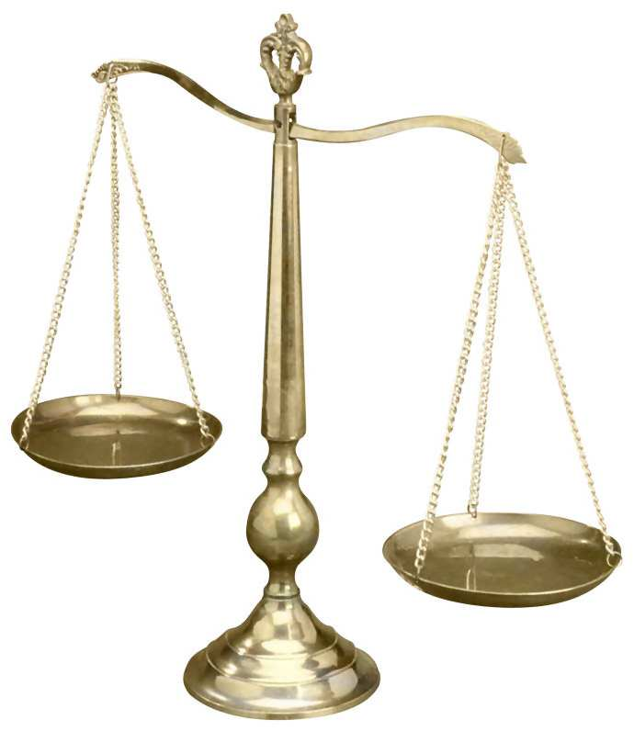
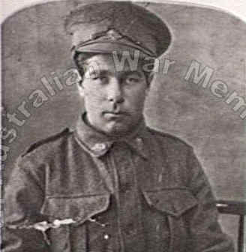
Aboriginal Participation
Many Aboriginal men were skilled trappers and hunters, they were often called on to act as patrol leaders, safely guiding soldiers through dangerous enemy territory.
The armed Forces was the only place where some Aboriginal men were treated equally in society. Unfortunately post WWI & WWII, Gov’t benefits to Aboriginals were less than non aboriginal benefits.

Slide 13
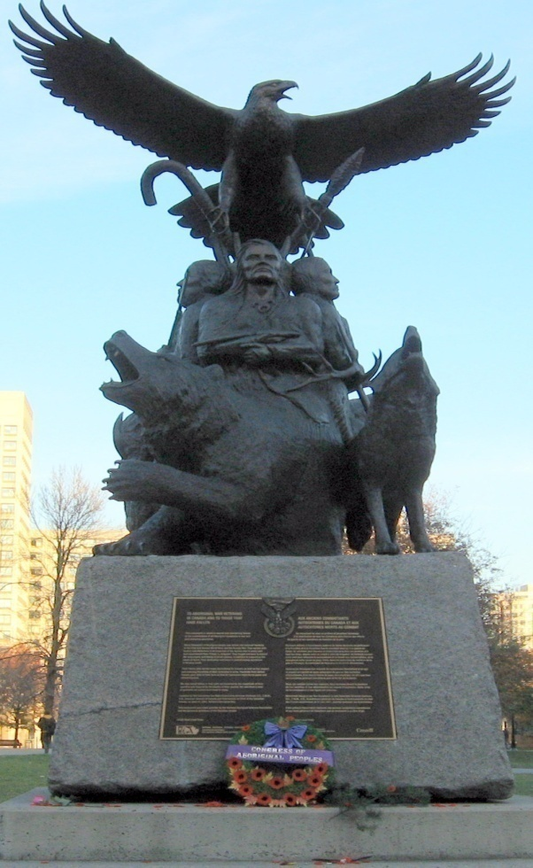
2001 Governor General dedication...
2001 GG Adrian Clarkson dedicated the Aboriginal Veterans War Monument in Ottawa – a gesture to thank Aboriginal
soldiers for the role they
played in fighting for Canada
in several wars.

Slide 14
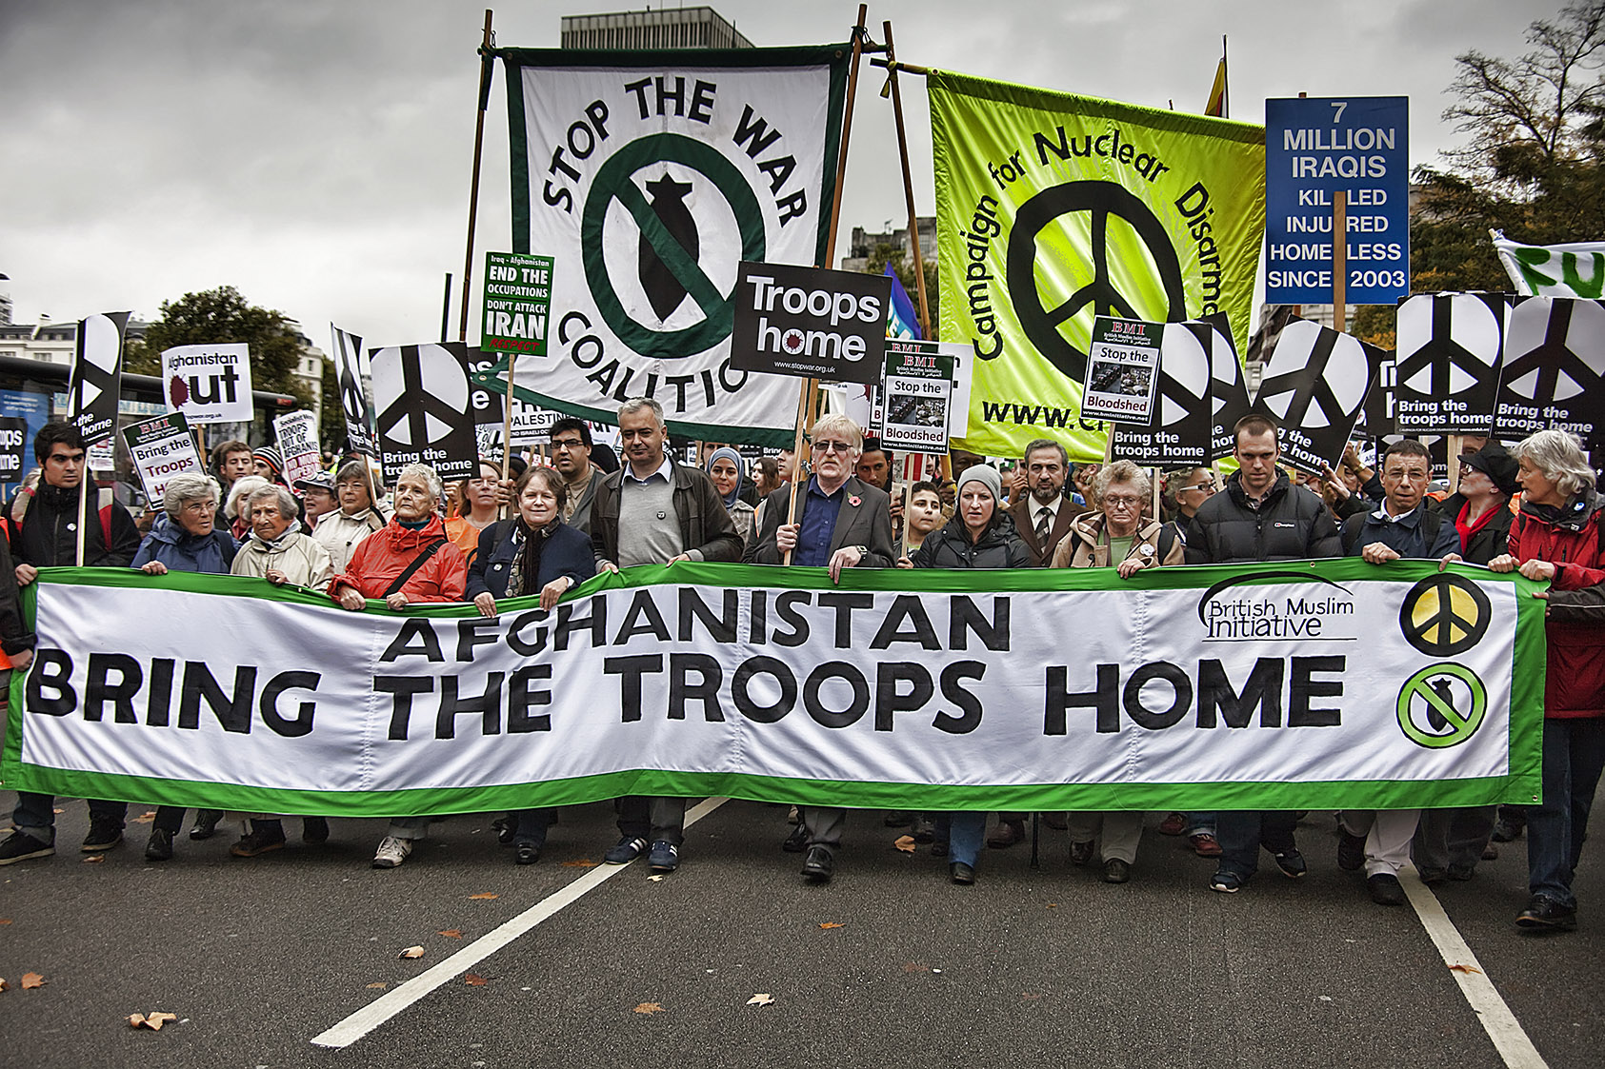
Citizenship and Anti-War Movements
Individuals can express their citizenship in a democratic society by taking part in movements or protests against their gov’ts decision to participate or not participate in war.

Slide 15
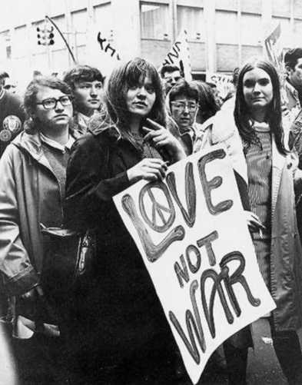
Citizenship and Anti-War Movements- The Vietnam Anti-War Movement
1954-1975 North Vietnam vs. South Vietnam (USA backed)
Attempt to hold back communism
Anti-War movement began slowly in the 1960’s as public opinion generally supported limited US intervention. The spread of communism was seen as a threat to the values of Liberalism (Cold War Period)
and capitalism and the
American way of life.

Slide 16
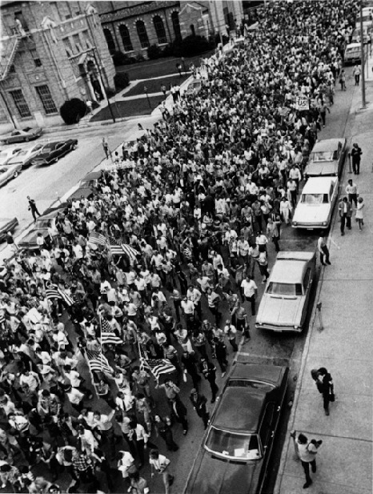
Vietnam
With the increase of American casualties, many Americans began to question the legitimacy of American involvement in the war.

Slide 17
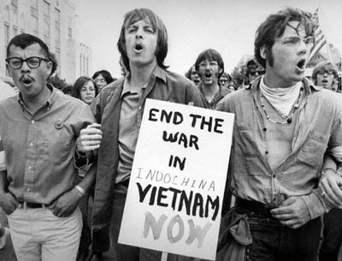
Muhammed Ali
Refused to be drafted into the military – opinion polls showed that the majority of Americans did not think that US interference in the politics of a foreign country was legitimate.
Thus the anti-war
movement grew.

Slide 18
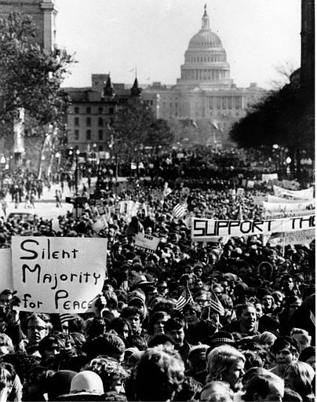
Anti-War Movement
Began in US colleges and universities during the 1960’s when more troops were being sent to Vietnam
By the end of 1968, 500 000 soldiers in Vietnam
November 15, 1969 – the largest
peace march in US history brought
500 000 protesters to Washington

Slide 19
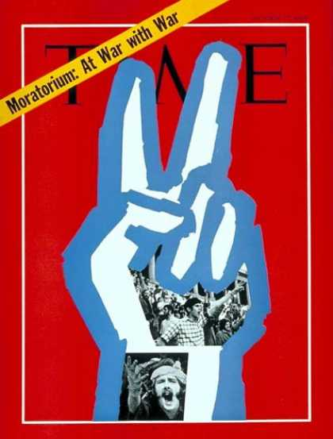
Media and the Anti War Protests - Vietnam
Television had a huge impact on public opinion and helped the anti-war movement grow.
Many American’s began to question their country’s role in Vietnam and their own responsibility as citizens.

Slide 20
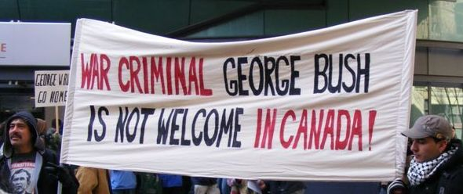
Anti-War Protests and the War in Iraq
March 20, 2003 the USA, Great Britain and other countries invaded Iraq
In months leading up to the invasion many people help anti-war rallies and marches
In Canada, anti-war protests were held in cities across the country-Vancouver, Edmonton, Calgary, Winnipeg, Toronto, Montreal, Halifax.

Slide 21
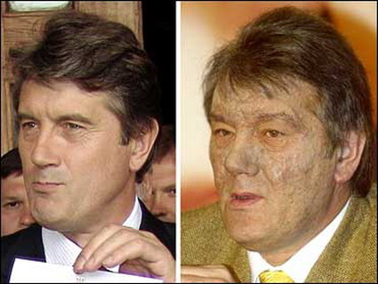
Citizenship and Pro-democracy Movements
November 21 2004, citizens of the Ukraine went to the polls to vote in a presidential election.
Candidates: Viktor Yushchenko (pro-Western candidate) and Viktor Yanukovych backed by the Russian Gov’t
Problems for Yushchenko during the campaign – interference by Yanukovych and dioxin poisoning. Blood tests showed he was poisoned with a key
ingredient of Agent
Orange – a herbicide
used in the Vietnam war

Slide 22
The Orange Revolution
On election day, numerous allegations of election fraud, voter intimidation, multiple voting and the burning of ballot boxes in areas of strong Yshchenko support. Yanukovych was declared the winner of the election.
Nov. 22 – the following day massive protests erupted against the election results.

Slide 23
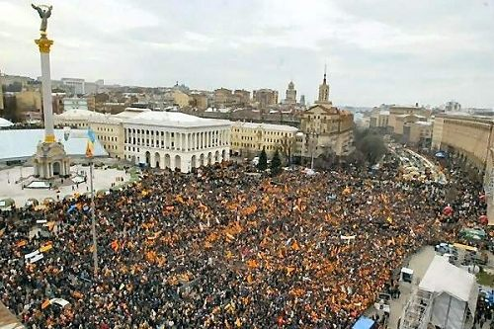
The Orange Revolution
Hundreds of thousands of people, many wearing orange (Yushchenko’s campaign colors) descended on central Kiev to peacefully state their objection to the apparent election fraud and to begin a pro-democracy movement in the Ukraine. It lasted 2 weeks, eventually a new
election was held and
Yushchenko won.
A peaceful protest by
citizens changed the
history of a country.

Slide 24
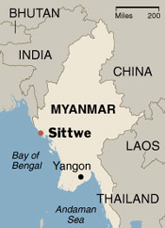
Pro-democracy Movements in Myanmar
Previously known as Burma has been ruled by the military since 1962.
Since the late 1980’s many clashes between pro-democracy supporters and the gov’t have led to the arrests, imprisonment, and deaths of thousands of pro-democracy supporters each year.

Slide 25
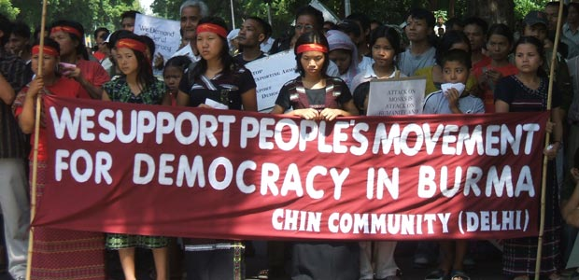
Pro-democracy Movements in Myanmar
Democratic candidate won an overwhelming victory in a 1990 election, but the results have been ignored by the Myanmar government.

Slide 26
Citizens and Government during times of peace

Slide 27
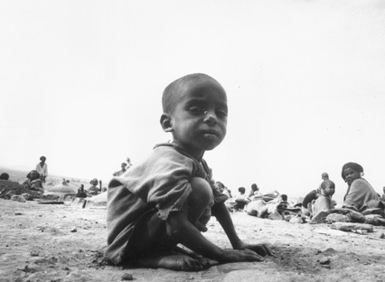
Famine Relief in Africa
1984 BBC reported that a civil war and drought in Ethiopia had resulted in a massive famine. Over a million died, 8 million were facing starvation.
Canadian Gov’t gave $50 million, but since then money has not been consistent.

Slide 28
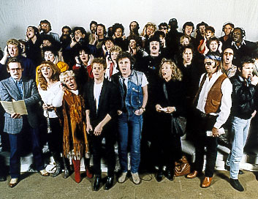
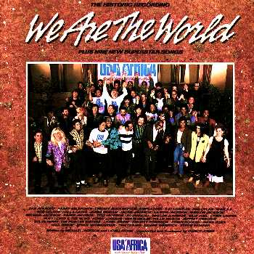
Tears are Not Enough
Canadian, British and American musicians began organizing concerts (Live Aid, We Are the World, Northern Lights-Tears are not enough) donated time and talent to raise $$ for the victims of Ethiopia

Slide 29
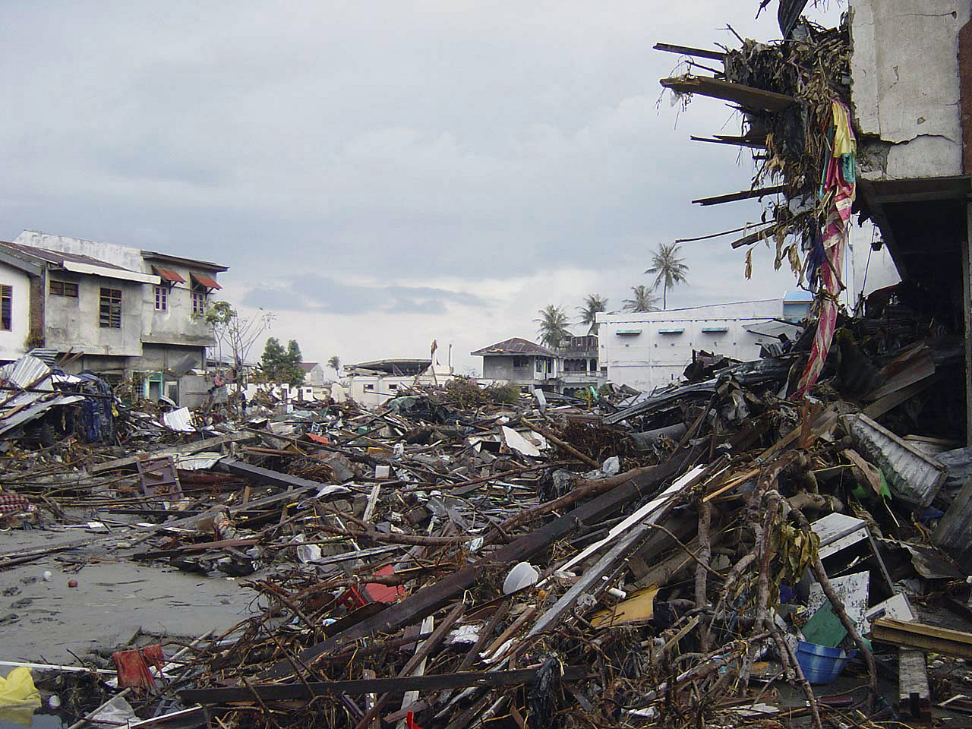
Responding to the 2004 Tsunami
2004 powerful earthquake off the coast of Indonesia caused a tsunami that hit countries in the Indian Ocean region.
200 000 people died and millions were left homeless
Canadian gov’t would match individual Canadian donations - $425 million sent over in total

Slide 30
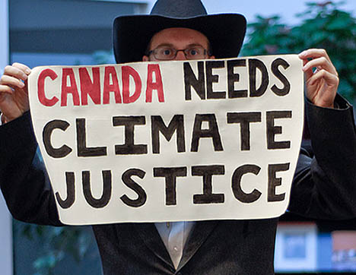
Responding to Climate Change
Environmental issues concern many Canadians.
The way citizens respond to global warming and its effects depends on how they see their rights and responsibilities regarding the environment. (becomes a global issue)
Some citizens join
political parties (Green
party) which advocates
care of the environment

Slide 31
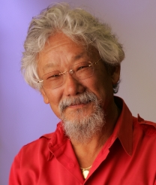
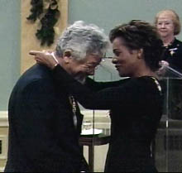
David Suzuki and the Role of Citizens
Scientist, environmentalist, broadcaster – advocating for the perspective of social and environmental change in Canada and has commented widely on the role and responsibilities of citizens in bringing about those changes.

Slide 32
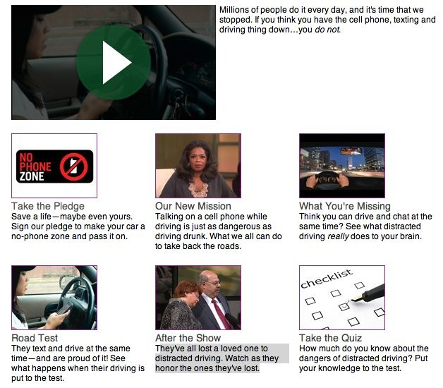
Grassroots Movements
Begin when a few people share a belief about how a situation – often in their own communities – must be changed

