Slide 1
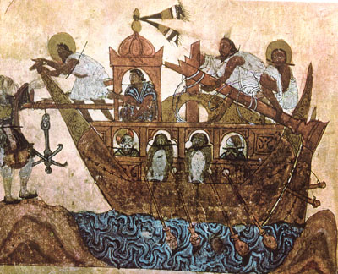
RI#2 Historical Globalization
To what extent did early globalization affect peoples of the world?

Slide 2
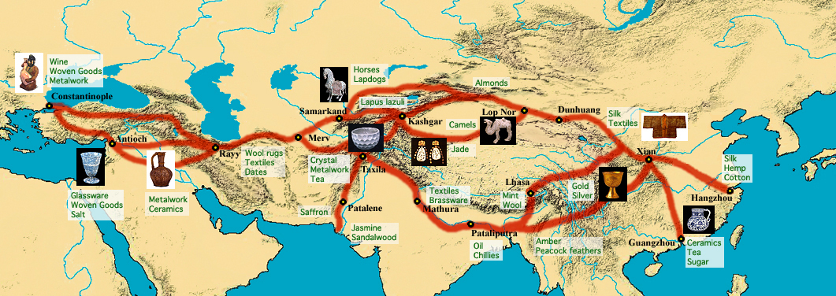
Why or how did early globalization begin?
Early Trade Routes
The Silk Road
linked Asia and Europe
Indo-Arabic number system adopted
Ideas Exchanged

Slide 3
Theory of Evolution of Globalization
1st Round
Goods/ideas exchanged along early trade routes
Knowledge of East Indian science, math, literature, and medicine to Europe

Slide 4
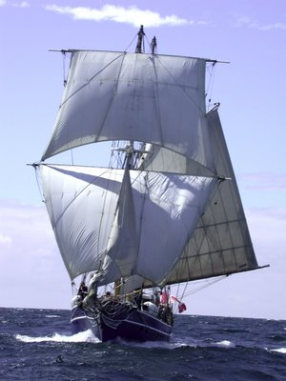
2nd Round
Europeans developed new technologies
Faster and farther sailing enabled
European Imperialism

Slide 5
3rd Round
Currently occurring
Rapid growth of world markets
Will be marked by the rise of China and India as economic powers
Concept of Historical Globalization
Sheshabalaya's second Round
Christopher Columbus

Slide 6
How did the foundations of historical globalization affect people?
Rise of a European Middle Class
Social status determined by wealth
People became independent in order to survive
Individualism
New values and opinions nationwide
Trade became even more important
Profits increased by expansion

Slide 7
Embracing New Ideas
New ideas and technologies
supported by growth of towns and cities and by increasing importance of trade
Indo-Arabic number system
Helped lay the foundations of historical globalization

Slide 8
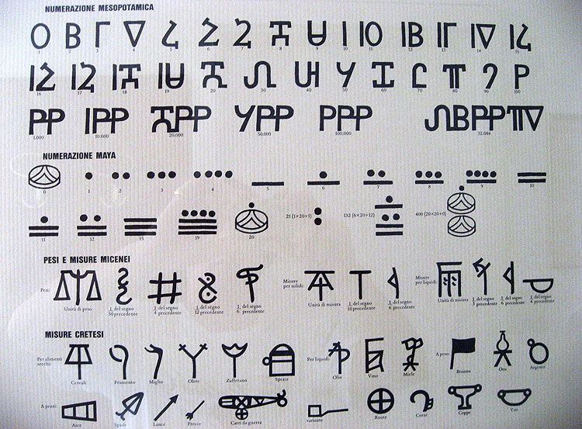

Slide 9
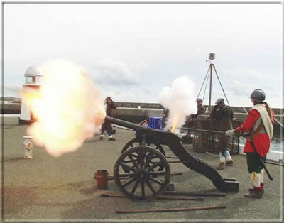
New Ideas, New Technologies, and Historical Globalization
9th-13th century innovations to develop technologies
Made travel, trade, exploration, and conquest easier.
Introduction of new sails
Improvements in navigational technology
Gunpowder, muskets, and
cannons produced

Slide 10
Global Competition for Trade
Race to establish colonies
European imperialism motivated
Mercantilism
Colonies viewed as a source of cheap raw materials
Government extremely strict in trade
1776 rebel in American colonies against mercantilism
Capitalism began to be developed
European Colonial Settlement
Indigenous land and resources taken over
Indigenous people enslaved, tortured, and killed
Naval power and weapons helped Europeans achieve this

Slide 11
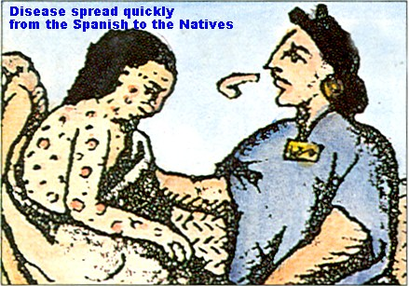
How did the consequences of historical globalization affect people?
Results of Contact
Indigenous people forced off their land
Acculturation
European diseases passed on to indigenous peoples

Slide 12
Differing Approaches to the Indigenous Peoples of the Americas
Northern indigenous peoples had a better relationship with Europeans because the Europeans relied on the indigenous peoples to survive and traded with them
Southern indigenous peoples treated poorly by Europeans
Conflicts
Efforts to halt the destruction of indigenous cultures in the South
Las Casas (Spanish priest/historian)

Slide 13
Slavery
Chattel slavery
Africans enslaved
Child labor
Indentured labor
Responses to Slavery
Olaudah Equiano's autobiography criticizes the harsh treatment of slaves
People finally begin to understand the true horror of the situation
Abolitionist movement begins to grow
La Amistad

Slide 14
The Grand Exchange
Industrialization and Social Change
Industrial Revolution
1750-1850
Traditional craftspeople driven out of work
Britain led this revolution, being the first to industrialize.

Slide 15
Key Terms (Ch. 5)
Imperialism - One country's domination over another country's economic, political, and cultural institutions.
Historical Globalization - A period that is often identified as beginning in 1492, when Christopher Columbus made his first voyage to the Caribbean, and ending after World War 2, when the United States and the Soviet Union emerged as superpowers.
Mercantilism - A policy followed by European imperial powers from the 16th to the 19th century. In colonies, trade was strictly controlled to benefit the economy of the imperial power.
Capitalism - An economic system that advocates free trade, competition, and choice as a means of achieving prosperity.

Slide 16
Grand Exchange - A trading process that began when Christopher Columbus brought seeds, fruit trees, and livestock to the Americas, where they were cultivated and became staples. In return, native North American species were exported to Europe. This exchange expanded to include different countries and products around the world.
Industrial Revolution - The period between about 1750 and 1850, when work became mechanized and began to occur in factories. The Industrial Revolution brought about dramatic economic, social, and cultural change.
Acculturation - The cultural changes that occur when two cultures accommodate, or adapt to, each other's worldviews.

Slide 17
Chapter 6 - Legacies of Globalization
To what extent do the legacies of historical globalization affect peoples of the world?

Slide 18
What are some legacies of historical globalization?
Ethnocentrism and Eurocentrism
Building Empires
Imperial Powers
The Scramble for Africa
African peoples not consulted
King Leopold and the Congo
Forced indigenous peoples to give up land and resource
Enslaved indigenous peoples
Harvesting rubber
Resistors killed, beaten, or mutilated
Kept atrocities secret for a long time

Slide 19
How has cultural contact affected people?
Legacies and Patterns of Historical Change
Languages exchanged
Legacies of migration
Fleeing conflict to begin a new life
Legacies of displacement
Indigenous peoples displaced with arrival of European settlers
Traditional government and community boundaries ignored
European colonizers had a strong disregard for traditional indigenous beliefs, traditions, and lives
Lead to civil war, starvation, and culture destruction

Slide 20
-Legacies of depopulation
-Forced migration of African slaves
-African depopulation
-Famine, disease, and slavery
-East Indian depopulation

Slide 21
How has the exchange of goods and technologies affected people?
-First Nations Trades with Europeans
-Buffalo endangerment
-Contact and Cultural Change in India
-The British East India Company
-World's first unofficial transnational corporation
-The Raj
-British rule in India
-Cotton and deindustrialization
-British put trade tariffs on cloth and cotton from India
-Crushed the cotton industry in India
-Cotton trade and Mohandas Gandhi
-Wanted people to be self-sufficient

Slide 22
How are the legacies of historical globalization continuing to affect people?
Cultural Change
Imperialism changed not only economic relations but also indigenous cultures
Art, religious beliefs, and values were all changed
Languages continuously being lost
Legacies of Imperialism in India
India's constitution made it a parliamentary democracy based on the British model
India separated into India and Pakistan to separate Muslims and Hindus
Riots frequent, people attacked and killed over their religious beliefs

Slide 23
Key Terms (Ch. 6)
Legacy- Something that has been passed on by those who lived in the past.
Ethnocentrism- A word that combines "ethnic" and "center". It refers to a way of thinking that centers on one's own race and culture. Ethnocentric people believe that their worldview is the only valid one.
Eurocentrism- A form of ethnocentrism that uses European ethnic, national, religious, and linguistic criteria to judge other peoples and their cultures.
Depopulation- A reduction in population caused by natural or human-made forces such as famine, war, or displacement.

Slide 24
Deindustrialization- The reduction in or loss of industries.
Gross Domestic Product (GDP)- The value of all the goods and services a country produces in a year. GDP is often used to measure the strength of a country's economy.
Historical Globalization- A period that is often identified as beginning in 1492, when Christopher Columbus made his first voyage to the Caribbean, and ending after World War 2, when the United States and the Soviet Union emerged as superpowers.

Slide 25
Chapter 7 - Legacies of Historical Globalization in Canada
To what extent have the legacies of historical globalization affected Canada?

Slide 26
How did historical globalization affect Canada?
Early Conflict
Usually friendly, co-dependant
Colonization in Canada
Fur trade in Canada marked by change in focus
Finding a route to Asia to finding a better way to collect furs
First Nations played a huge role
Trapping of animals
Transportation of pelts

Slide 27
First Peoples and European Settlers
First Nations taught Europeans how to survive
Natives believed status ₌ ability, and land could not be owned _{VS} European belief that status ₌ wealth, and land ownership was key to wealth
Oral treaties of the Natives _{VS} European written treaties
Destruction of the Beothuk Culture
Hunted and killed by Europeans
Driven inland away from their traditional natural resources
Starvation
Died of European diseases

Slide 28
What are some legacies of historical globalization in Canada?
Seven Year's War
France _{VS} Britain
Followed by separation
Some Legacies of Early French Rule
Government wanted to attract settlers
Land divided and given to seigneurs
Long, narrow lots close to water
Difficult to defend

Slide 29
-Ouendat _{VS} French conflict for 20 years
Social changes
Catholic Church stayed strong
Settlers attached to their new land
Less willing to accept orders from France
Independence and self-reliance

Slide 30
Some Legacies of Early British Rule
Clashing Cultures
Farming settlements proposed
Métis already inhabiting the land forced out
Tensions and violence, along with war

Slide 31
European Immigration
English became widely spoken
Mercantilism introduced
Eurocentric ideals, beliefs, and values

Slide 32
How has historical globalization affected the indigenous peoples of Canada?
Depopulation of the First Peoples
First Nations driven out of their land
European diseases and conflict
Assimilation
The Numbered Treaties
Europeans could read and understand the treaties; Natives could not understand or read the treaties.
The Indian Act
Banned some traditional practices
Only those who moved off reserves could vote
Illegal to pursue land claims

Slide 33
Residential Schools
Were mandatory
Christian/government responsibility
Legacies of residential schools
Abuse
Controversy about compensation
Punished for speaking their own language
Cut off from culture

Slide 34
How do some legacies of historical globalization continue to affect Canada?
Immigration
Diverse in languages, perspectives, and cultures
Multiculturalism
Rejects assimilation
Controversial
Land Claims
Treaties fulfilled and claims made
Many claims remain unsettled
The Quiet Revolution in Quebec

Slide 35
Key Terms (Ch. 7)
Indian Act- First passed by the Canadian Parliament in 1876 and amended several times since then, this act continues to define who is, and isn't, a status Indian. Early versions of the act banned some traditional practices of First Nations cultures and allowed only those who renounced Indian status to vote in federal elections.
Status Indian- A First Nations person who is registered according to the provisions of the Indian Act and is therefore eligible to receive specific benefits.
Residential Schools- Boarding schools where First Nations children gathered to live, work, and study. These schools were operated or subsidized by the Canadian government as an important element of the government's assimilation policy. The last residential school shut down in 1996.

Slide 36
Cultural Mosaic- A society that consists of many distinct cultural groups.
Multiculturalism- An official Canadian government policy founded on the idea that Canadian society is pluralistic - made up of many culturally distinct groups who are free to affirm and promote their own cultural identity.
Cultural Pluralism- The idea that a variety of peoples are free to affirm and promote their customs, traditions, beliefs, and language within a society.

Slide 37
Quiet Revolution- A period of intense social, political, and economic change in Quebec. During this period, which lasted from 1960 to about 1966, Quebecois began to assert their rights and affirm and promote their language and culture.
Controversy- A dispute that is a matter of opinion over which parties actively disagree, argue, or debate. These arguments can range in size from private disputes between individuals to large-scale disagreements between societies.
Compensation- Something given or received as a payment or reparation.
Assimilation- A process that occurs when the culture of a minority group is absorbed by another culture. The cultural identity of the minority group disappears as its members take on the identity of the other culture.
Perspectives- A point of view or outlook on a certain situation.

Slide 38
Chapter 8 - Living With the Legacies of Historical Globalization
To what extent have attempts to respond to the legacies of historical globalization been effective?

Slide 39
How effectively have people responded to the legacies of historical globalization?
One Response
AVEGA Agahozo
Rwandan widows and survivors
Rwanda - A Response to Historical Globalization
Tutsis and Hutus = Indigenous groups
had power Laborers
Lived Peacefully
Claimed by Germany, then given to Belgians after World War 1
Belgium government completely separated Hutus and Tutsis
Favored Tutsis, gave them power

Slide 40
Belgians left
Heated conflicts between Hutus and Tutsis broke out
Hutus formed a government of their own and began campaigning against Tutsis and their supporters
Peace agreement in 1993 "ended fighting"
Genocide
Hutu militants and Rwandan governments targeted Tutsis
Tutsis fled the country
Tutsis killed and mutilated by fires and machetes, women raped
After new government was established, Hutus fled the country
New wave of refugees.

Slide 41
International response to genocide
UN officials refused to become involved
Peacekeepers couldn't legally interfere unless in self-defense
Failed to help stop the genocide
Failed to acknowledge the genocide
Rebuilding Rwandan society
Justice and reconciliation
Rebuilding of the economy
Rebuilding of coffee plantations
International Support
Groups/individuals helping Rwandan women
Women for Women in Rwanda

Slide 42
How effectively have governments responded to the legacies of historical globalization?
UN and Indigenous People
Indigenous peoples not represented in UN
South Africa - Redressing Inequities
Eurocentric beliefs of the colonizers ensured that Indigenous people were always second-class
Racism as government policy
Blacks barred from voting

Slide 43
Apartheid
Introduced when indigenous people began to demand independence
Segregation in jobs, living areas, clothing, schools, etc.
1970s and 1980s groups struggled to end the apartheid by using violent and non-violent means
End of Apartheid
Marked by the student protest in Soweto
Officers opened fire on student protesters
The truth and reconciliation commission
South African government Mandela elected
Human rights sought, people's rights restored

Slide 44
Legacies of Historical Globalization in Canada
Internment of German, Ukrainian, and Japanese Canadians
Seen as "enemy aliens" during the first and second World Wars
Held in prison-like conditions
Finally receiving compensation

Slide 45
Legacies of the Indian Act
Continues to embody the legacies of colonialism
Royal Commission on aboriginal peoples
Statement of Reconciliation
Changing the Indian Act

Slide 46
How effectively have organizations responded to the legacies of historical globalization?
Non-Government Organizations
AVEGA Agahozo, Greenpeace International, Doctors Without Borders
Focus on social, political, environmental, human, and animal rights and sometimes deliver needed services
Great response

Slide 47
How does historical globalization continue to affect the world?
Global Income Inequality
Caucasian based countries have the highest in the world
Unequal Foreign Aid
Darfur
A repeat of Rwanda?

Slide 48
Key Terms - Chapter 8
Genocide- The mass killings of human beings, especially a targeted group of people. Usually has something to do with religious beliefs, race, etc.
Gacaca Courts- Community courts established in Rwanda to try low-level officials and ordinary people accused of taking part in the Rwandan genocide. The purpose of these courts was to speed up the process of bringing to justice those who had participated in the genocide and to encourage reconciliation.
Apartheid- An Afrikaans word that refers to a policy of segregating and discriminating against non-whites in South Africa.

Slide 49
Enemy Aliens- Labels assigned during World War I and World War II to people from countries that were at war with Canada. The rights of enemy aliens were sometimes restricted, and some were even interned in camps.
Non-Government Organizations- An organization established by groups of people to work toward specific goals and to gain public support in achieving these goals. NGOs depend on volunteer workers and donations, but they may also receive grants or contracts from governments. They may influence government policies at national and international levels.
Foreign Aid- Money, supplies, and other goods, as well as expertise, given by one country to another.

Slide 50
Gross National Income- The amount of money earned by everyone in a country.
Reconciliation- Changing for the better a relationship between two or more persons or groups of persons.
Commission- A special group delegated to consider an important issue.

