Slide 1

Nazism
-Fascism

Slide 2

Understandings Of Nazi Fascism
What are the Political, Economic and Social ideas to Nazi Fascism?

Slide 3
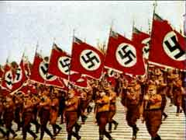
Political Ideas
Cult of the leader and elite rule.
Extreme nationalism.
Organized violence and war and military force.
It is in the country’s national interest to expand its territory.

Slide 4

ECONOMIC IDEAS
A government-directed private enterprise economy to serve the needs and interests of the state.
Anti-union/anti-workers rights.

Slide 5
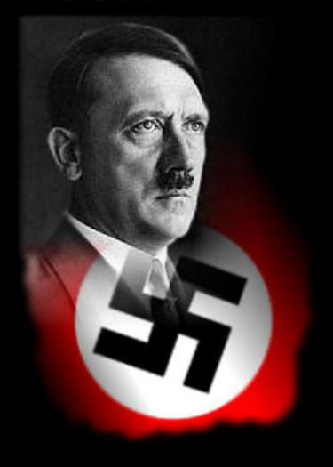
SOCIAL IDEAS
Inequalities between individuals and groups of people.
Racial purity.
Racial or national Superiority.
National strength more important than individual rights.

Slide 6
Maximum political freedom for individuals
Maximum economic freedom for individuals
Maximum political control by government
Maximum economic control by government
.
Political-economic grid based on the degree of economic and political freedom or government control favored by particular ideologies.
1 Democratic Socialism
2 Democratic Capitalism
3 Communism
4 Fascism

Slide 7
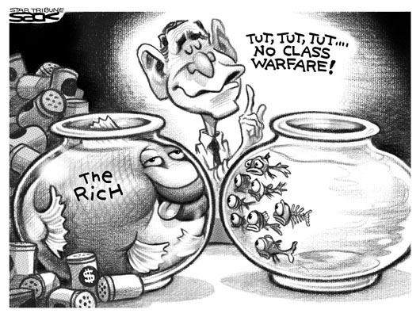
Social Darwinism
Social Darwinism is a evolution theory by Charles Darwin , it meant that ones who adapt to changes faster will beat the ones who fall behind when changes occur. It was know as “survival of the fittest” as well .
(Internet Definition)

Slide 8
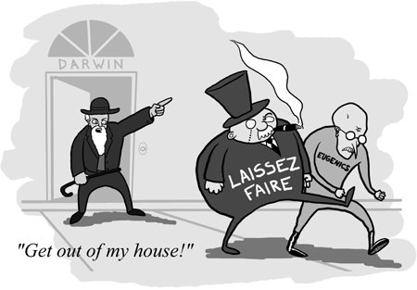
Social Darwinism And Fascists
The popular notion that animals evolve through competition and natural selection. Social Darwinism promotes the notion that some individuals or groups achieve power and advantage over others because they are stronger or fitter. Some Fascists adopted this idea to use them to justify policies that discriminated against people, often with violence

Slide 9
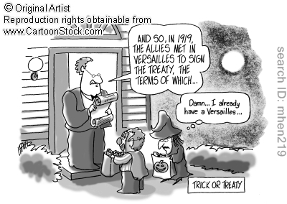
The treaty of Versailles
The treaty included the following terms:
Germany must give up some of its own territory and all of its overseas colonies.
Germany must accept responsibility for causing all loss and damage to allied governments.
Germany must pay the equivalent of 20,000,000,000 gold marks ( 4.5 billion dollars ) in reparations to Allied governments between 1919 and 1921, and an additional 80,000,000,000 gold marks (with interest ) after this time.

Slide 10
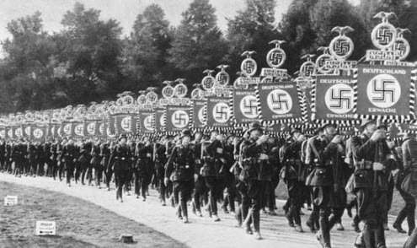
Hitler and the Rise of Nazism
In the 1920’s, Hitler began to rise power in the Nazi party. By 1923 he decided that the party would need to seize power by force. After he attempted to take over the government by force and it failed , he was sent to jail, and the Nazi party was banned. While in prison, Hitler wrote a book describing his understandings of Fascism.

Slide 11
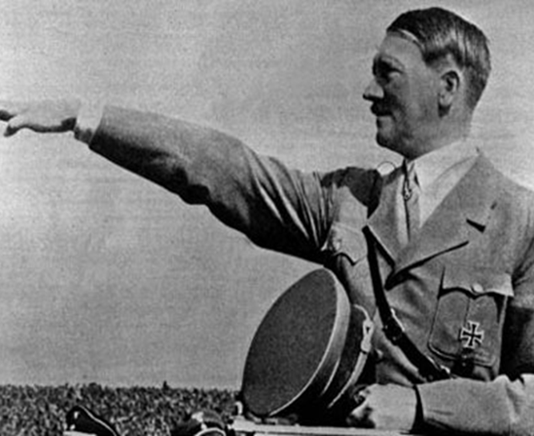
Hitler The Dictator
Hitler created his own form of Fascism, Nazism. To ensure the support of the German people, Hitler used such techniques such as the following.
Propaganda
Youth movements
The elimination of his opposition
The use of terror and force (the SS)
Scapegoats (The Jewish population)
These techniques encouraged the rejection of the political values of liberalism in Germany. Hitler used his own version of fascism to take away individual rights and freedoms from people he did not deem part of his ideal society.

Slide 12
Techniques of Dictatorships
Censoring the media, for example, writers and artists, and controlling participation
Glorifying the leader and his accomplishments
Rewriting curriculum and textbooks to portray the glory of the nation and the leader
Holding rallies, giving powerful speeches, and creating youth movements to teach “accepted” values
Using propaganda, indoctrination, terror and force
Using The military or police, and violence, to create a climate of fear
Removing leaders or parties that pose a threat to the dictator
Holding elections in which it is impossible for people to vote for anyone else

