Slide 1
National Self-Determination
Chapter 8 – page 180
So 2.9

Slide 2
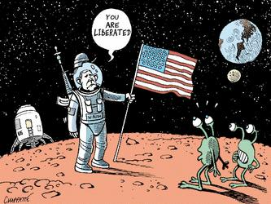
What is National Self-Determination?
People are trying to gain or keep the power to control their own affairs
They want to make their own decisions about what is in their national interests.

Slide 3
National Self-Determination Case Study’s
Timor-Leste
Vietnam
Cambodia
India
Pakistan
Kashmir
Tibet

Slide 4
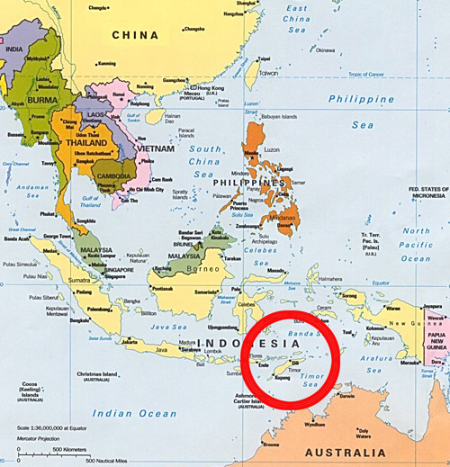
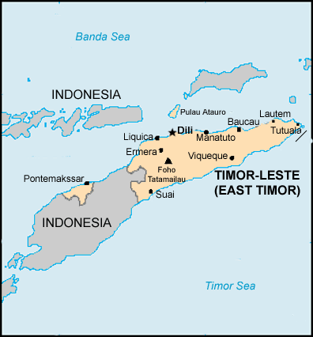
Timor-Leste
Also know as East Timor – was a colony of Portugal.
When the Portuguese left in 1975, Indonesia invaded Timor-Leste.

Slide 5

U.N. Intervention?
The U.N. demanded the invaders leave - didn’t, yet the U.N. did nothing to force them
So for years, the people of Timor-Leste struggled to gain self-determination.
200 000 Timorese had been killed, and the country in ruins.

Slide 6
Plebiscite
In August 1999, U.N. held a plebiscite (a non-binding vote) in Timor-Leste.
Question was….do you want complete independence or to remain part of Indonesia? Most chose independence, but a violent minority were violently opposed.

Slide 7
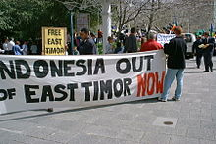
Self-Determination is difficult for Timor-Leste
In 2002, Timor-Leste officially gained independence and a U.N. mission was sent to keep peace.
That mission ended in 2005, but in 2006 the mission reopened because of violence.

Slide 8
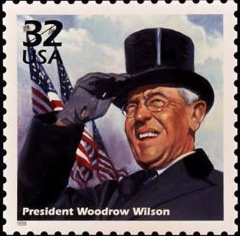
Self-Determination in 1918
President Wilson called for ‘free self-determination of nations’ in Northern Europe.
It did not apply to other nations such as Timor-Leste.

Slide 9
Self-Determination and Nation States
Self-determination can unite or drive people apart. The violence in Timor-Leste after the plebiscite was caused by conflicting ideas of self-determination.
The UN charter states who has the right to self-determination and what this right means.
But the charter does not say what happens when people within sovereign countries want self-determination.

Slide 10
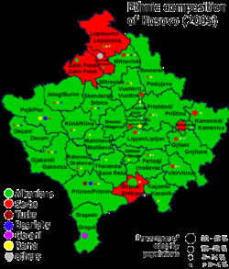
Kosovo – SD or Sovereignty(pg 175)
Until Kosovo declared independence in 2008, it had been a province of Serbia.
Many Albanian (green) Kosovars welcomed independence, but many Serbian (red) Kosovars did not (meant
losing part of their country).
An independent Kosovo
threatened Serbian
Sovereignty.

Slide 11
Picturing the Pursuit of Self-Determination
There are 4 different types of Self-Determination:
1. Political SD
2. Cultural SD
3. Economic SD
4. Social SD

Slide 12
Types of National Self-Determination – complete attachment #1 –handin.
Type of National Self-Deter | What do people want to control? | What does the photo show? | What conflicting interests are involved? | What other photo would show something similar?
Political
Cultural
Economic
Social
Examine the photographs on pages 176-77 to complete the following chart:

Slide 13
Political SD…example
Type of National SD | What do people want to control? | What does the photo show? | What conflicting interests are involved? | What other photo would show something similar?
Political | A gov’ts actions; control over territory | Princip –Serb –hoping this act would lead to a slavic nation | Slav’s national interests vs. Austria’s interests in keeping an empire | Taliban fighters in Afghanistan

Slide 14
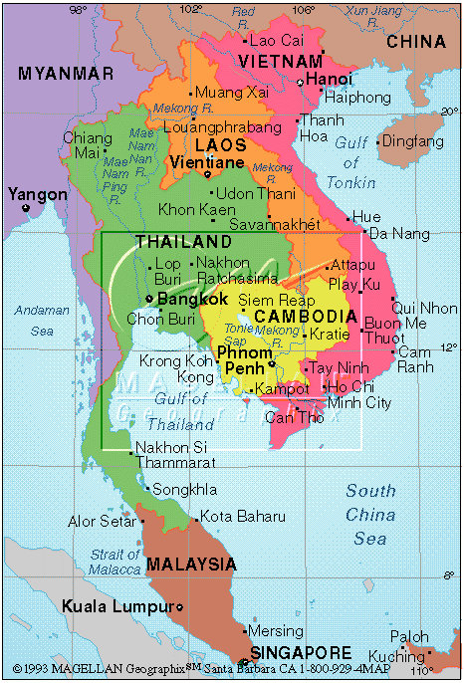
Pursuing National Self-Determination in Indochina
By the early 1900’s, much of SE Asia was ruled by European countries.
France controlled Vietnam,
Laos and Cambodia and
renamed the region French
Indochina.

Slide 15
Japan invades Indochina
When Japan invaded Indochina during WWII, some people wanted to pursue NSD.
In Vietnam, Ho Chi Minh (communist) founded the Viet Minh = independence movement to fight the Japanese.
When WWII ended, France took back original control of Vietnam, but Ho & the Viet Minh kept fighting for independence.

Slide 16
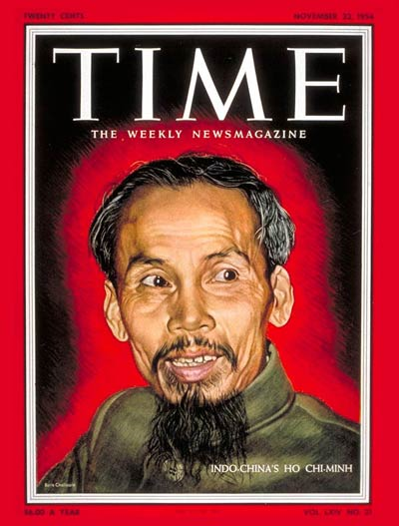
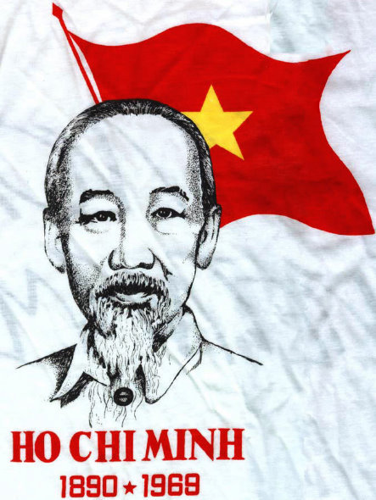

Slide 17
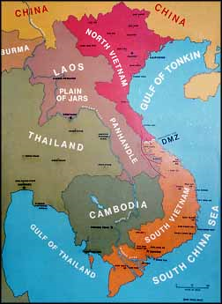
North & South Vietnam
The war between the
Vietnamese and the French
finally ended in 1954 with the
defeat of France.
Vietnam was divided into the
communist north (supported
by China & SU) and the
democratic south (supported by US).

Slide 18
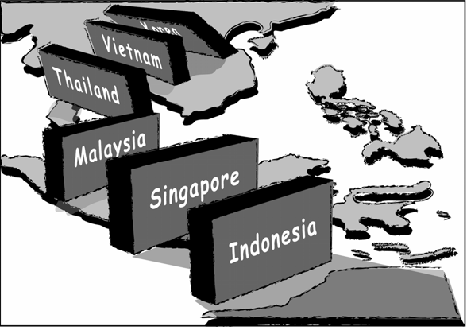
Vietnam
1969 – 500 000 US troops fought North Vietnam and into Cambodia.
America national interest was to stop the spread of communism in SE Asia.
President Eisenhower
used the domino theory
to explain how communist
China and Russia might
take over all SE Asia

Slide 19
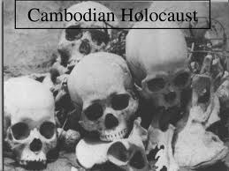
Cambodia
1976, Communist leader, Pol Pot and the Khmer Rouge party controlled the country.
For years people were brutalized by them. They had to give up their religion, private property, money.
1.5 million were starved
murdered or died under
Pol Pot’s dictatorship

Slide 20
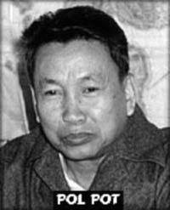
Seeking Justice in Cambodia
Vietnamese forces overthrew Pol Pot in 1979.
Cambodia became a constitutional monarchy (democracy) but was still unstable.
1993 Cambodians voted in UN
supervised election, but peace
was not achieved until 1998.

Slide 21
Self-Determination in India
At the beginning of the 20th century, Britain ruled over India, Pakistan, Bangladesh and Sri Lanka.
Britain had trading rights (East Indian Company) over India, much like British had the Hudson’s Bay Company in Canada.
1858, British had direct control over India, and they did not consult the people – Indian national interests were not considered.

Slide 22
The Rise of Indian Nationalism
20th century – Indian nationalist movements gained strength – wanted the right to control themselves.
British allowed them a parliament, with very little power.
1920’s – Mohandas Gandhi (lawyer) began to emerge as leader of self-determination movement in India.

Slide 23
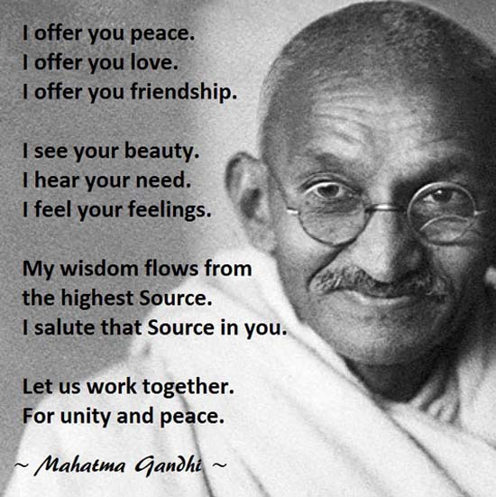
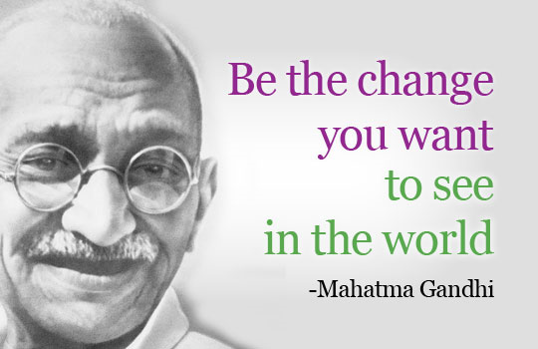
-fought for rights for South Africans
-believed in non-violence, civil disobedience
-salt march

Slide 24
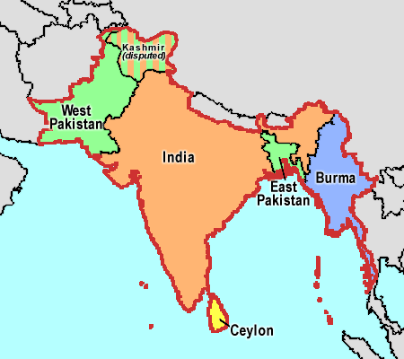
Creation of Pakistan pg 181
Mohandas Gandhi wanted Muslims and Hindus to live together in one country.
Muhammad Ali Jinnah (leader of the Muslim League) wanted
Muslims
to have their own
country. Ali’s
ideas prevailed.
Muslims moved from
India to Pakistan and
Hindus went from Pakistan to India.

Slide 25
Kashmir NSD
Kasmiri people lived in a clearly defined territory in the NW Himalaya Mountains. They spoke Kashmiri, a distinct language and were a distinct cultural group.
1947, British, Indian & Pakistan leaders decided that Kashmiris should have the right to decide whether to join India or Pakistan.
UN held a plebiscite on the issue. But before this occurred, India invaded and took control of the Kashmir territory.

Slide 26
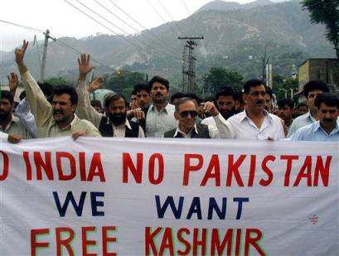
Kashmiri people have never been allowed to vote on their future.
Kashmiri people have resisted Indian control, and this has often led to violence.
Today, many Kashmiri people want complete independence, not join India or Pakistan
Many Kashmiri
people have
disappeared in
India occupied
Kashmir.

Slide 27
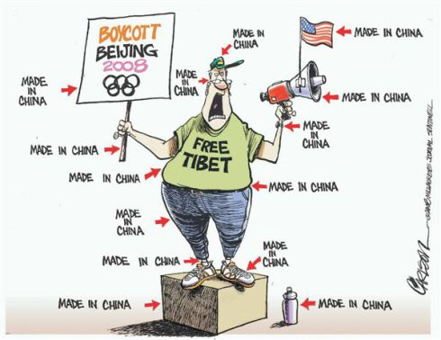

NSD in Tibet
2008, China (Beijing) hosted the Summer Olympics.
Tibet took the opportunity to publicize their demands for national self-determination.

Slide 28
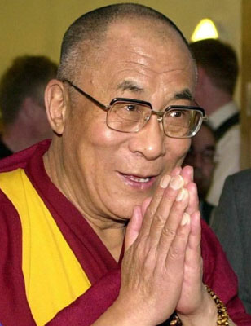
Tibet & China
The Autonomous Region of Tibet is a province of China.
Tibetans had their own
culture, language, traditions
and religion (ruled by the
Dalai Lama – hold political
and spiritual power.

Slide 29
UN and Tibet
1950, when India and Pakistan were establishing their own independent gov’ts, China invaded Tibet.
The Dalai Lama asked the UN for help.
He said the people of Tibet have been ‘compelled by force to become a part of China against their will and consent’.
UN said China and Tibet should resolve the problem.

Slide 30
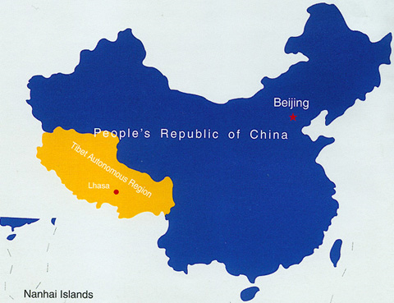
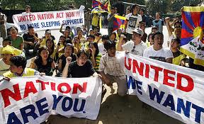
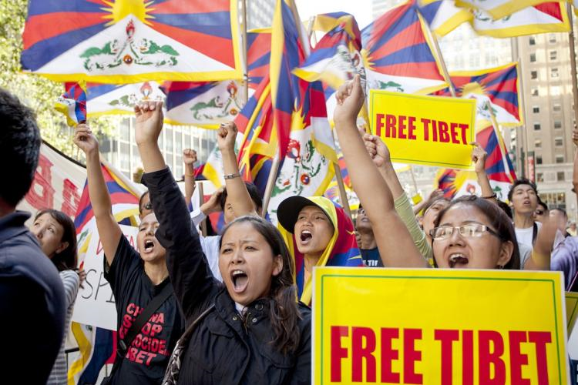

Slide 31
The Struggle Continues…
As the Chinese took greater control of the gov’t, the Dalai Lama and his gov’t fled to India.
The Chinese put down the Buddhist religion, destroyed monasteries and outlawed Tibetan customs and culture.
Thousands of Tibetan civilians and Buddhist monks and nuns were killed, imprisoned or sent in exile…Tibetan cultural genocide.
Complete Attachments 2 & 3. Hand in.

Slide 32
National Self-Determination in Canada
First Nations
Inuit
Metis
Quebec

Slide 33

Aboriginal Independence
Long before the British and the French came to Canada, Aboriginals were independent.
They made their own laws, provided their own physical and economic security, and lived by their own cultures and values.

Slide 34
First Nations Pursuit of SD
Assembly of First Nations (AFN) believe self-determination involves the right of people to freely:
  Decide their own political status and pursue their economic, social and cultural development
  Dispose of and benefit from their wealth and natural resources

Slide 35
Conflicting Ideas
A people’s right to self-determination may conflict with a nation-state’s right to sovereignty
In 1990, Aboriginals told the Royal Commission on Aboriginal People’s that they did not want independence, but they wanted the right to self-government.
Told that SD includes governance, so Indigenous peoples are entitled to choose their own gov’t within existing states

Slide 36
Self-Determination must include…
Settling land claims and regaining control of economic development
Passing on to their children their culture and values…several educational offer teaching of First Nations culture and history.

Slide 37
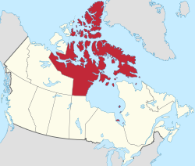

Inuit Pursuit of Self-Determination
1999 – Creation of Nunavut demonstrates how the Canadian gov’t and Aboriginal Communities can work successfully together.

Slide 38
Metis Pursuit of Self Determination
Alberta is the only province in Canada with Metis Settlements (degree of self-governance)
Metis Nation of Alberta continues to fight for the right to self-determination and self-government.

Slide 39
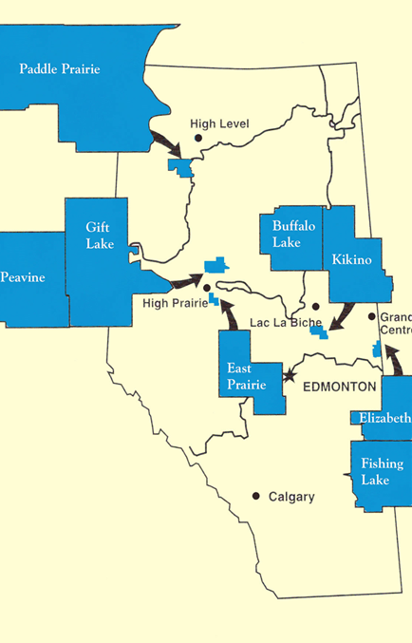
Metis Settlements in Alberta

Slide 40
Quebec and National Self-Determination
Francophone Quebecois identify themselves as a distinct cultural group.
They share a language, historical tradition and a traditional territory.
Many Aboriginal/English speaking Quebecers may not want to pursue SD which may clash with French Separatists.

Slide 41
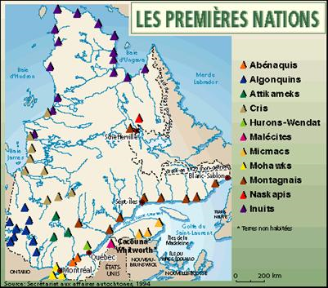
“If Quebec leaves Canada, Aboriginals would leave Quebec and stay with Canada”

Slide 42
Unintended Results of Pursuing National Self-Determination
Page 191-193

Slide 43
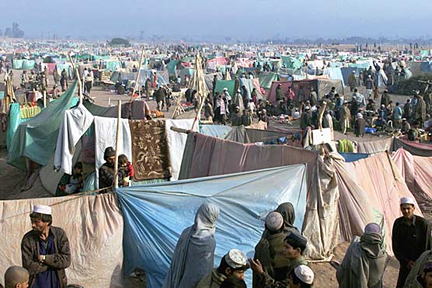
Realities of Self-Determination
Often, people often lose their homes, personal security, economic prosperity and if they leave their homeland, may lose their cultural heritage.

Slide 44
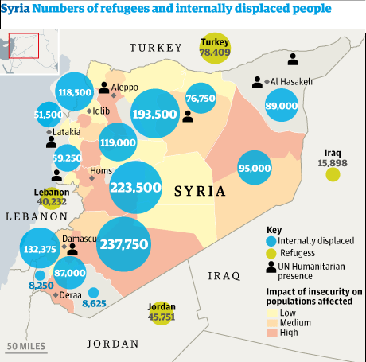
Refugees
2006 – nearly 32 million people around the world were living as refugees
A refugee is someone who is forced to leave their home to seek safety because of war, natural disaster, or persecution.

Slide 45
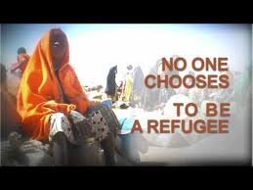

Slide 46
Host Countries
Are the countries that take in refugees.
The sudden arrival of a flood of refugees can strain the resources of a host country and often causes resentment.
UN and NGO’s try to assist.
Some Afghan refugees have been in Pakistani refugee camps since 1979

Slide 47
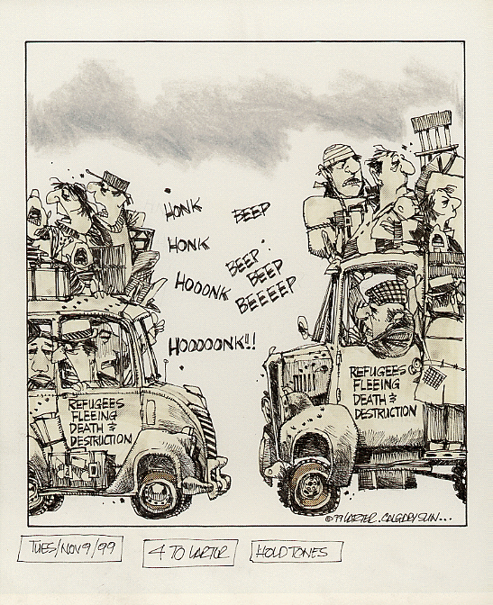
Refugees were fleeing conflicts in many areas.
Host countries were also trying to send many refugees away…
What is the cartoonists message about refugees’ chance of finding safety?

