Slide 1
Mr O’s Magic Source Analysis System
*not actual magic.

Slide 2
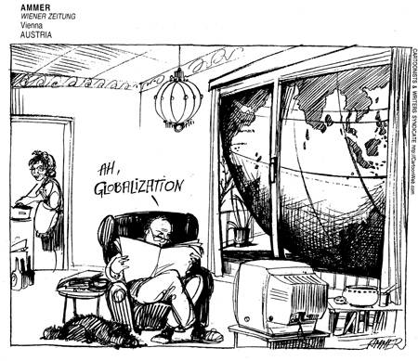
Cartoon or Visual Source De-construction
You can use this for Source Analysis or for answering Multiple choice questions!
Explicit messages
Describe the source as if you were explaining it to a blind man
Who? What? When? Where? Why?
Evidence!

Slide 3
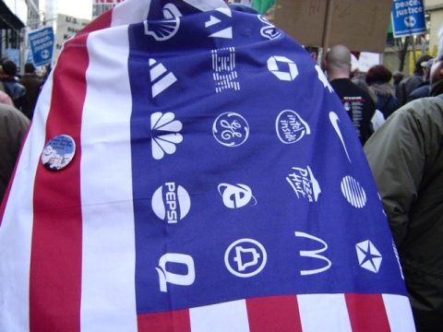
Cartoon or Visual Source De-construction
Implicit Messages
What is the purpose of the source?
What is the reason it was created?
What is the main idea?
What is the Related issue connection?
What is the message?
Evidence!

Slide 4
Cartoon or Visual Source De-construction
Perspective
What is the perspective of the author on the topic?
What is the author in favour of (pro)?
What is the author opposed to (con)?
Be specific?
Evidence?

Slide 5
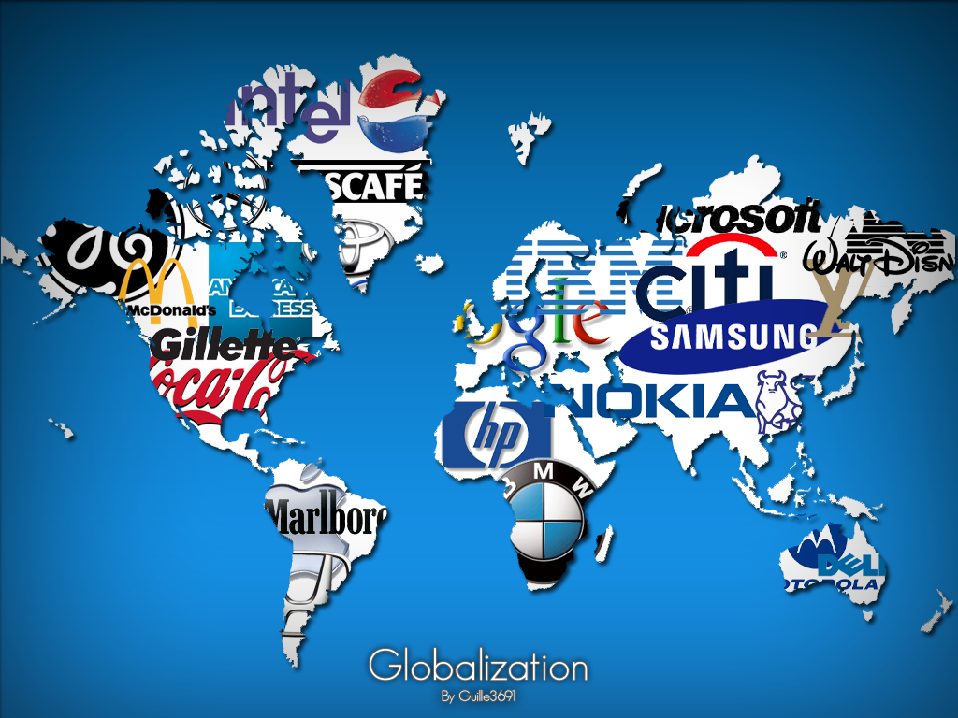
Cartoon or Visual Source De-construction
Links to the course
Globalization is not enough!
Related issue – be specific
Use related course vocabulary and concepts
Contemporary and historical connections

Slide 6
Relationships Paragraph
State the “big” connecting idea. This links directly to the concepts of the curriculum – think bracketed terms!
Agreement and disagreement:
Specific areas of agreement – based on principals, or concepts
Specific areas of disagreement – based on principals or concepts
Agreement or disagreement based on elements of social studies (social, political, economic, environmental)
Vision of the future vs. understandings of the past
Philosophical (thinkers) agree and disagreement

Slide 7
Text Source Analysis
You can use this for Source Analysis or for answering Multiple choice questions!
You need a system – Create one that works for you:
Hi-lighting
Boxes
Write in margin
chart

Slide 8
Text Source Analysis
Title – Underline and put a “T” beside it – if no title make one up (big idea).
Explicit - Summary – put a square around it or write a brief summary of what the source is about beside the source – explain the source

Slide 9
Text Source Analysis
Identify Key terms – zig-zag underline. Vocabulary, course concepts, philosopher identify them
Implicit Meaning (see above)
Perspective – What is the perspective, opinion, bias of the writer? What are they in favour of? Opposed to? What is their opinion on Globalization?

Slide 10
Text Source Analysis
Relationships Paragraph:
State the “big” connecting idea. This links directly to the concepts of the curriculum – think bracketed terms!
Agreement and disagreement:
Specific areas of agreement – based on principals, or concepts
Specific areas of disagreement – based on principals or concepts
Agreement or disagreement based on elements of social studies (social, political, economic, environmental)
Vision of the future vs. understandings of the past
Philosophical (thinkers) agree and disagreement

Slide 11
Look at the Rubric!
[T]he opposition between globalization and local traditions is false: globalization directly resuscitates local traditions, it literally thrives on them, which is why the opposite of globalization is not local traditions, but universality. —Slavoj Zizek, Serbian social critic

Slide 12
The requirement of one state for one people on one territory has proved to be a recipe for nightmare without end. —Jonathan Schell, contemporary American writer

Slide 13
When the missionaries came to Africa, they had the Bible and we had the land. They said "let us close our eyes and pray." When we opened them, we had the Bible, and they had the land. —Desmond Tutu

