Slide 1
Mr O’s Magic Source Analysis System
*not actual magic.

Slide 2
The Task
We are asked to do a Source Analysis as part of our final exam – this is NOT a position paper and we do evaluate or judge or agree/disagree with the sources.
The Task is broken down into four paragraphs.
In the first three paragraphs we analyze the three sources – one source per paragraph using the following method
The final paragraph is for comparing the similarities and differences and agreement and disagreement between the three sources
You can use this for Source Analysis or for answering Multiple choice questions!

Slide 3
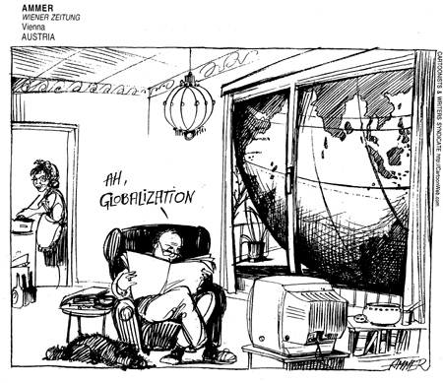
Cartoon or Visual Source De-construction
For each source write a paragraph using the following steps:
STEP ONE:
Explicit messages
Describe the source as if you were explaining it to a blind man
Who? What? When? Where? Why?
Evidence!

Slide 4
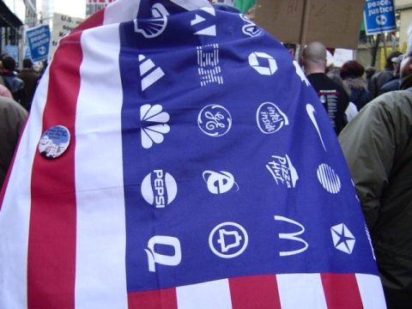
Cartoon or Visual Source De-construction
STEP TWO
Implicit Messages
What is the purpose of the source?
What is the reason it was created?
What is the main idea?
What is the Related issue connection?
What is the message?
Evidence!

Slide 5
Cartoon or Visual Source De-construction
STEP THREE
Perspective
What is the perspective of the author on the topic?
What is the author in favour of (pro)?
What is the author opposed to (con)?
Be specific?
Evidence?

Slide 6
Cartoon or Visual Source De-construction
STEP FOUR
Links to the course
Globalization is not enough!
Related issue – Identity, Historical Legacies, Sustainable Prosperity – be as specific as posible
Use related course vocabulary and concepts
Make contemporary and historical connections

Slide 7
Relationships Paragraph
This is for the final or fourth paragraph
Here we compare and contrast the three sources with each other
State the “big” connecting idea. This links directly to the concepts of the curriculum – think bracketed terms!
Agreement and disagreement:
Specific areas of agreement – based on principles, or concepts
Specific areas of disagreement – based on principles or concepts
Agreement or disagreement based on elements of social studies (social, political, economic, environmental)
Vision of the future vs. understandings of the past
Philosophical (thinkers) agree and disagreement

Slide 8
Text Source Analysis
This is very similar to the visual source deconstruction – but it is for text.
You can also use this for Source Analysis system for answering Position Paper or Multiple choice questions!
You need a system – Create one that works for you – you can use:
Hi-lighting
Boxes
Write in margin
chart

Slide 9
Text Source Analysis
When you see a piece of text if it has a titile then underline it – titles tend to summarize the main points of the text source.
If it does not have a title – Create a Title – think “big idea” – Underline and put a “T” beside it.
Explicit Meaning: In a long source it is important to very briefly summarize the source. You can write this in the margin – or if there is a sentence in the source that is summative put a square around it or some other way to indicate that this sentence explains the general idea of the source.

Slide 10
Text Source Analysis
Identify Key terms – highlight or circle or use a zig-zag underline – everytime you see a word that is part of the course vocabulary, a course concept, a philosopher or refers to a course idea - identify them
Implicit Messages
What is the purpose of the source?
What is the reason it was created?
What is the main idea?
What is the Related issue connection?
What is the message?
Evidence!

Slide 11
Text Source Analysis
Perspective or Bias
What is the perspective, opinion, bias of the writer?
What are they in favour of? Opposed to?
What is their opinion on Globalization?
Links to the course
Globalization is not enough!
Related issue – Identity, Historical Legacies, Sustainable Prosperity – be as specific as posible
Use related course vocabulary and concepts
Make contemporary and historical connections

Slide 12
Text Source Analysis Relationships
Relationships Paragraph:
State the “big” connecting idea. This links directly to the concepts of the curriculum – think bracketed terms!
Agreement and disagreement:
Specific areas of agreement – based on principals, or concepts
Specific areas of disagreement – based on principals or concepts
Agreement or disagreement based on elements of social studies (social, political, economic, environmental)
Vision of the future vs. understandings of the past
Philosophical (thinkers) agree and disagreement

Slide 13
Look at the Rubric!
[T]he opposition between globalization and local traditions is false: globalization directly resuscitates local traditions, it literally thrives on them, which is why the opposite of globalization is not local traditions, but universality. —Slavoj Zizek, Serbian social critic

Slide 14
The requirement of one state for one people on one territory has proved to be a recipe for nightmare without end. —Jonathan Schell, contemporary American writer

Slide 15
When the missionaries came to Africa, they had the Bible and we had the land. They said "let us close our eyes and pray." When we opened them, we had the Bible, and they had the land. —Desmond Tutu

