Slide 1
Mr O’s Magic Source Analysis System
*not actual magic.

Slide 2
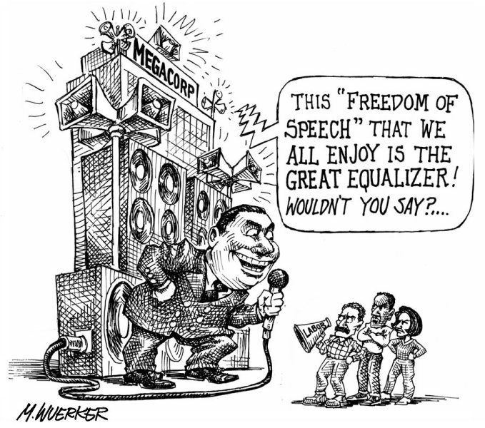
Cartoon or Visual Source De-construction You can use this for Source Analysis or for answering Multiple choice questions! You should brainstorm and write directly on the source!
STEP ONE
Explicit messages
Describe the source as if you were explaining it to a blind man
Who? What? When? Where? Why?
Use specific evidence from the cartoon

Slide 3
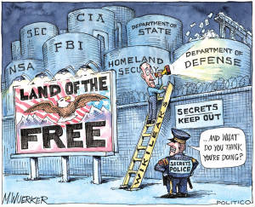
Cartoon or Visual Source De-construction
STEP TWO
Implicit Messages
What is the purpose of the author of the source?
What is the reason it was created?
What is the main idea?
What is the Related issue connection?
What is the message?

Slide 4
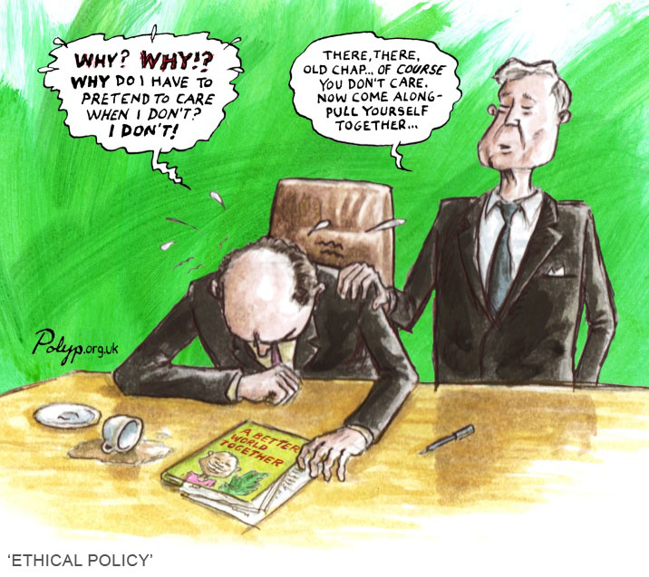
Cartoon or Visual Source De-construction
STEP THREE
Perspective
What is the perspective of the author on the topic?
What is the author in favour of (pro)?
What is the author opposed to (con)?
Who would agree with this perspective?
Who would disagree with this perspective?
Evidence?

Slide 5
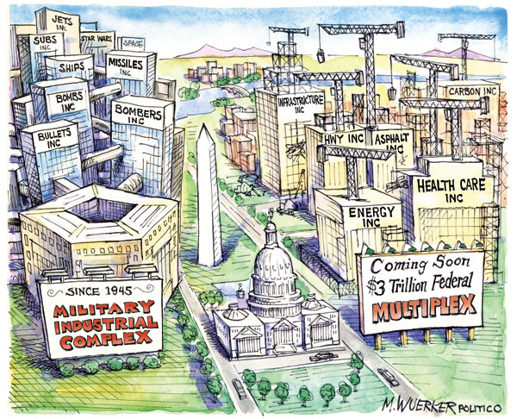
Cartoon or Visual Source De-construction
STEP FOUR
Links to the course
Liberalism is not enough!
Related issue – be specific
Use related course vocabulary and concepts
Contemporary and historical connections

Slide 6
Relationships Paragraph
State the “big” connecting idea.
This links directly to the concepts of the curriculum – think bracketed terms!
Start at liberalism
Think economic or political spectrums (compare locations)
Think about philosophers (who would agree or disagree)
Think about theme (is the author appealing to nation, class, race, relationship to land, gender, religion)
Agreement and disagreement:
Specific areas of agreement – based on principles of collectivism or individualism, or concepts
Specific areas of disagreement – based on principles of collectivism of individualism or concepts
Agreement or disagreement based on elements of social studies (social, political, economic, environmental)
Vision of the future vs. understandings of the past

Slide 7
Text Source Analysis
This is essentially the same as Cartoon or Visual Source Deconstruction but in response to a quote or piece of text!
You need a system to write use to brainstorm and “mark up” the quote – Create one that works for you:
Hi-lighting
Boxes
Write in margin
chart

Slide 8
Text Source Analysis
STEP ONE
Explicit Message
On the source identify the Title – Underline and put a “T” beside it – if no title make one up (big idea).
Identify Key terms (zig-zag underline) Vocabulary, course concepts, philosophers, phrases, ideologies, historical or contemporary events – basically identify words you recognize from the course.
Begin writing by Summarizing – put a square around the summative sentence in the source begin your writing with a brief summary of what the source is about – explain the source.

Slide 9
Text Source Analysis
STEP TWO Implicit Meaning
Use the same process as in the Visual Deconstruction to identify Implicit Meaning of the source
STEP THREE Perspective
As with the Visual deconstruction write about the perspective, opinion, bias of the writer? What are they in favour of? Opposed to? What is their opinion on Liberalism?
STEP FOUR Connection to the course
Again the same as with the Visual Deconstruction

Slide 10
Text Source Analysis
STEP FIVE Relationships Paragraph:
State the “big” connecting idea. This links directly to the concepts of the curriculum – think bracketed terms!
Agreement and disagreement:
Specific areas of agreement – based on principals, or concepts
Specific areas of disagreement – based on principals or concepts
Agreement or disagreement based on elements of social studies (social, political, economic, environmental)
Vision of the future vs. understandings of the past
Philosophical (thinkers) agree and disagreement

Slide 11
Look at the Rubric! See the connections between the system and the government expectations http://oppieclass.weebly.com/writing1.html

