Slide 1
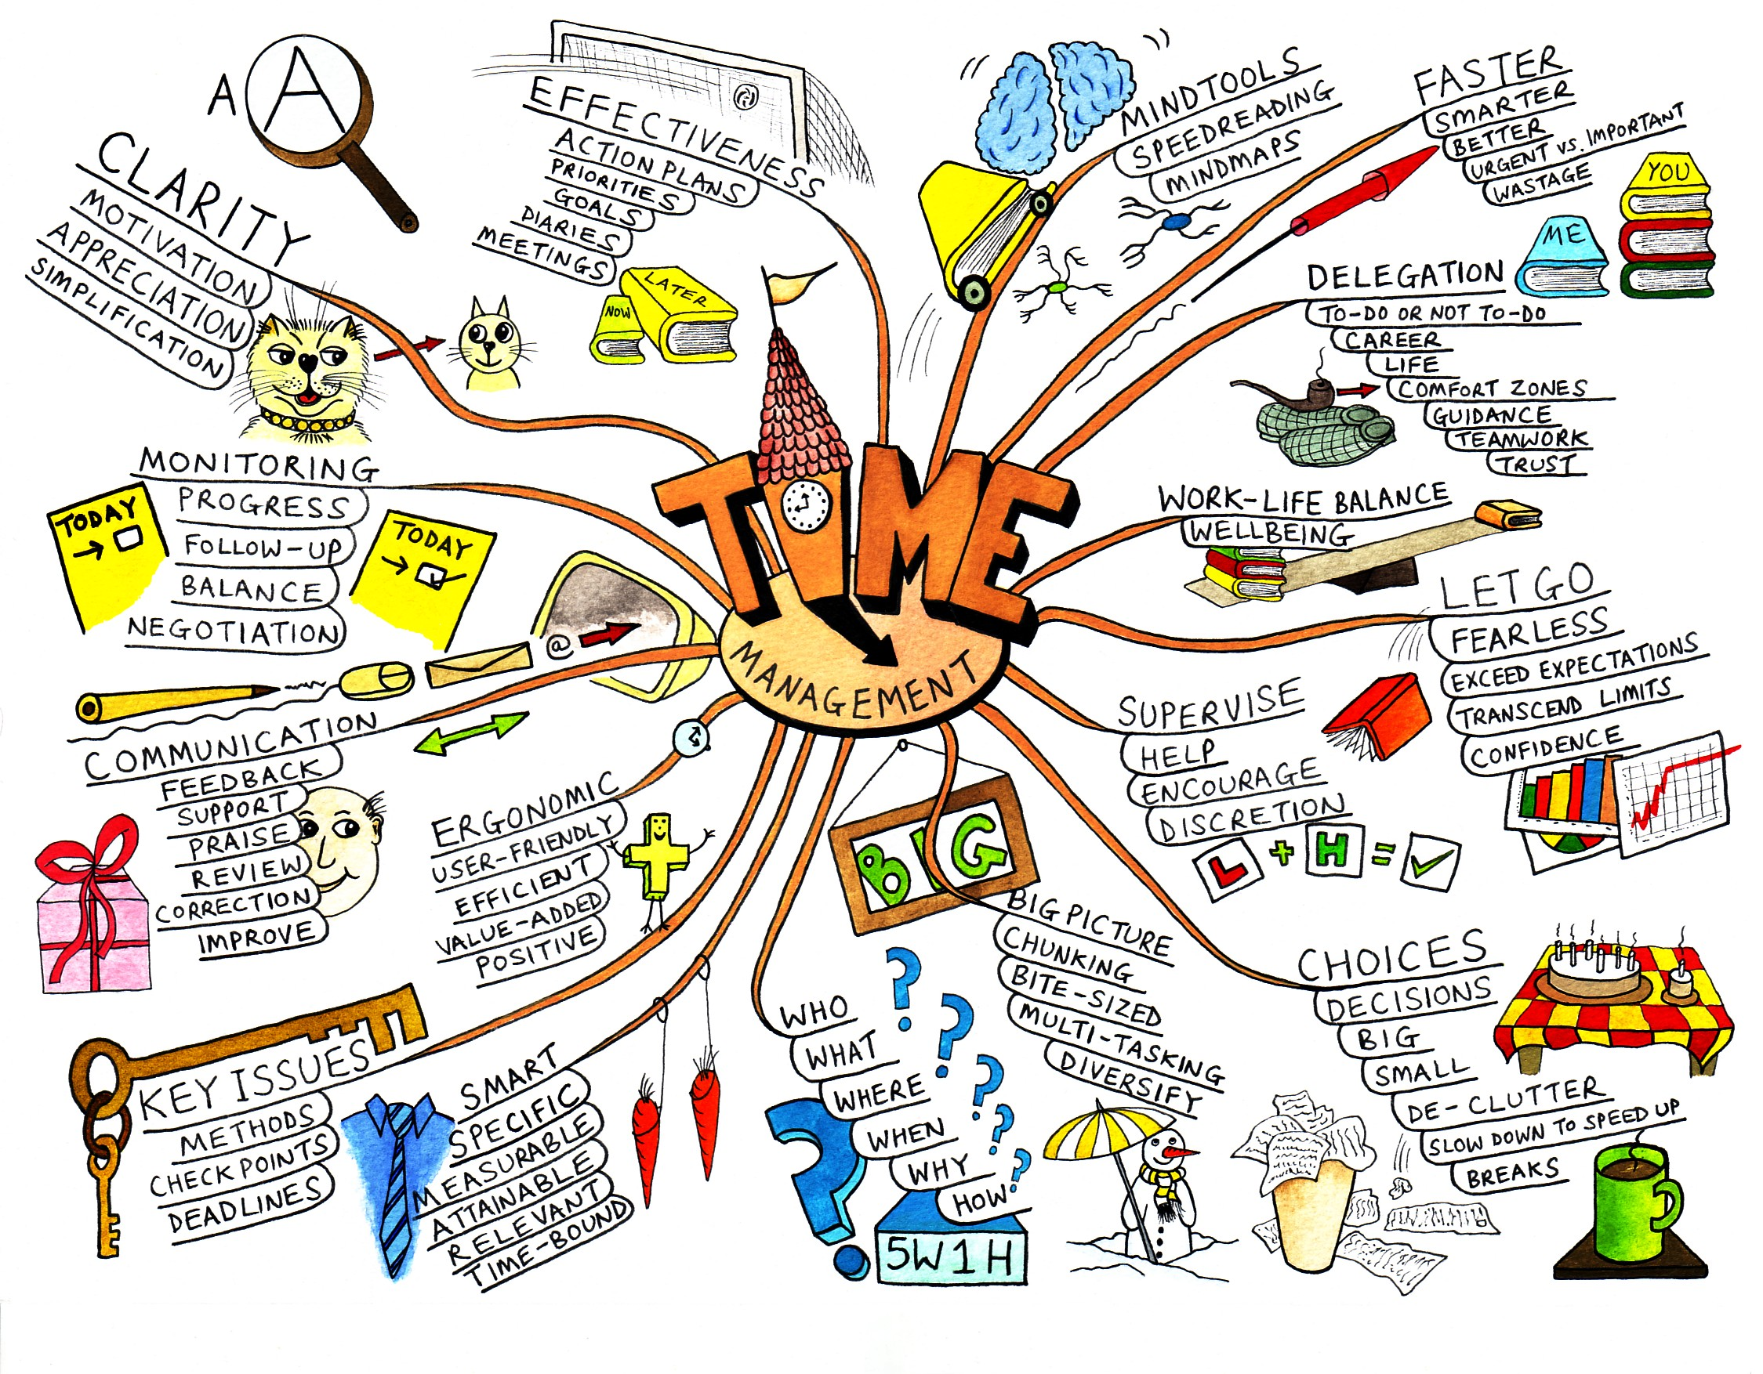

Slide 2
What is Mind Mapping?
A mind map is a diagram used to represent words, ideas, tasks, or other items linked to and arranged around a central key word or idea. Mind maps are used to generate, visualize, structure, and classify ideas, and as an aid to studying and organizing information, solving problems, making decisions, and writing.

Slide 3
What is Mind Mapping?
The elements of a given mind map are arranged intuitively according to the importance of the concepts, and are classified into groupings, branches, or areas, with the goal of representing semantic or other connections between portions of information. Mind maps may also aid recall of existing memories.

Slide 4
What is Mind Mapping?
By presenting ideas in a radial, graphical, non-linear manner, mind maps encourage a brainstorming approach to planning and organizational tasks. Though the branches of a mindmap represent hierarchical tree structures, their radial arrangement disrupts the prioritizing of concepts typically associated with hierarchies presented with more linear visual cues. This orientation towards brainstorming encourages users to enumerate and connect concepts without a tendency to begin within a particular conceptual framework.

Slide 5
What is Mind Mapping?
The mind map can be contrasted with the similar idea of concept mapping. The former is based on radial hierarchies and tree structures denoting relationships with a central governing concept, whereas concept maps are based on connections between concepts in more diverse patterns

Slide 6
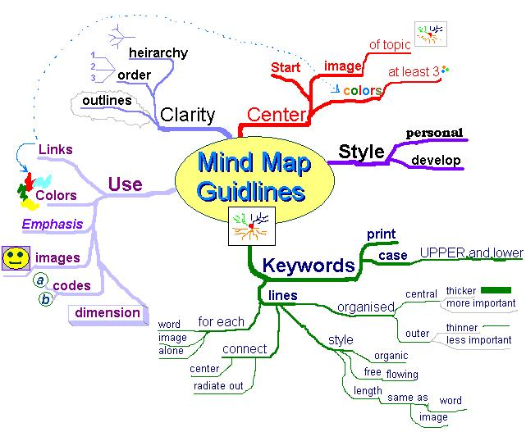
3
2
start
4
5
4

Slide 7
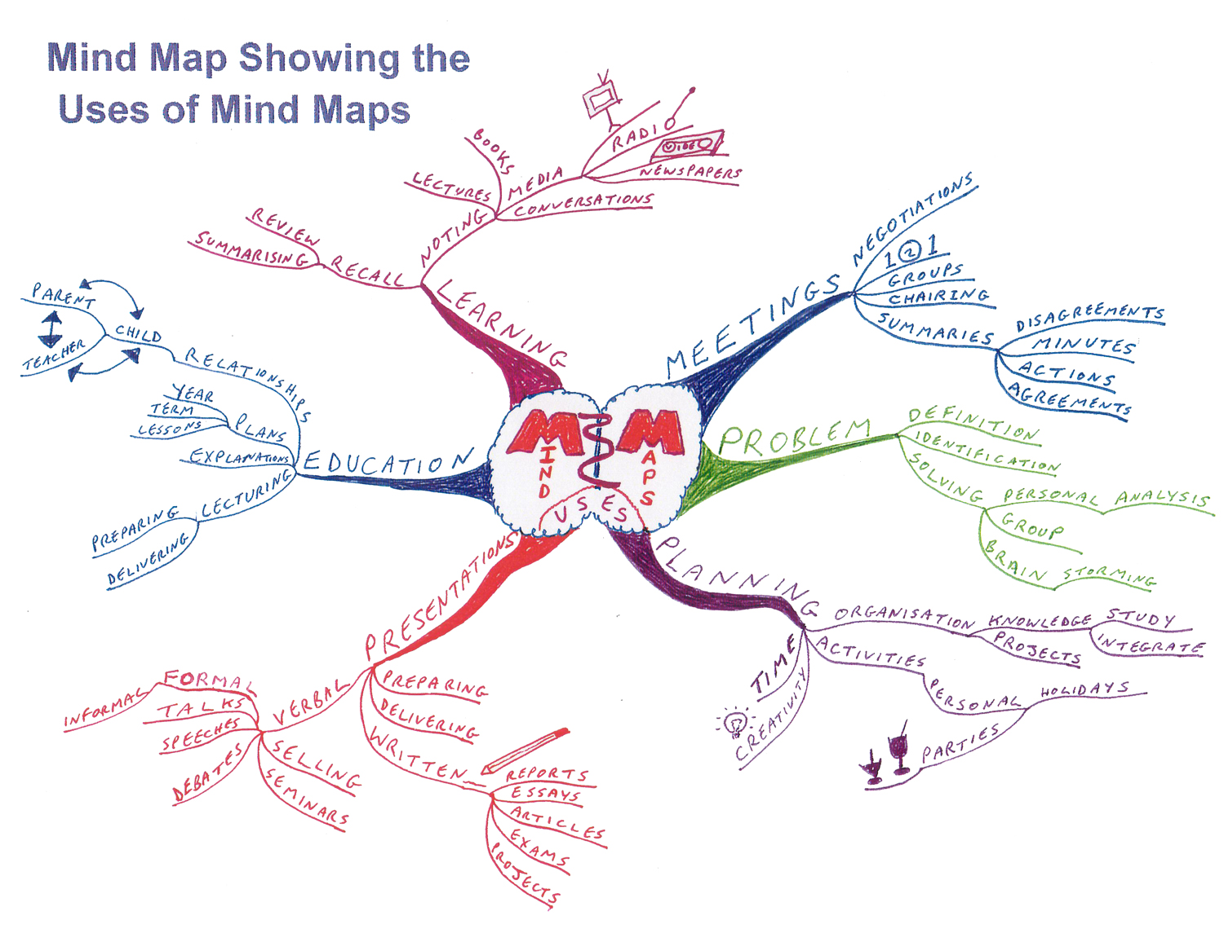

Slide 8
Mind Mapping
Mind map guidelines
Mind map of mind map guidelines
In his books on Mind Maps author Tony Buzan suggests using the following guidelines for creating Mind Maps:
Start in the center with an image of the topic, using at least 3 colors.

Slide 9
Mind Mapping
Use images, symbols, codes, and dimensions throughout your Mind Map.
Select key words and print using upper or lower case letters.
Each word/image is best alone and sitting on its own line.

Slide 10
Mind Mapping
The lines should be connected, starting from the central image. The central lines are thicker, organic and flowing, becoming thinner as they radiate out from the centre.
Make the lines the same length as the word/image they support.
Use multiple colors throughout the Mind Map, for visual stimulation and also to encode or group.

Slide 11
Mind Mapping
Develop your own personal style of Mind Mapping.
Use emphasis and show associations in your Mind Map.
Keep the Mind Map clear by using radial hierarchy, numerical order or outlines to embrace your branches.
This list is itself more concise than a prose version of the same information and the Mind Map of these guidelines is itself intended to be more memorable and quicker to scan than either the prose or the list.

Slide 12
Uses for Mind Maps
Uses
Rough mindmap notes taken during a course session
A mind map is often created around a single word or text, placed in the center, to which associated ideas, words and concepts are added.

Slide 13
Uses for Mind Maps
Mind maps have many applications in personal, family, educational, and business situations, including notetaking, brainstorming (wherein ideas are inserted into the map radially around the center node, without the implicit prioritization that comes from hierarchy or sequential arrangements, and wherein grouping and organizing is reserved for later stages), summarizing, revising, and general clarifying of thoughts. One could listen to a lecture, for example, and take down notes using mind maps for the most important points or keywords. One can also use mind maps as a mnemonic technique or to sort out a complicated idea. Mind maps are also promoted as a way to collaborate in color pen creativity sessions.

Slide 14
Uses for Mind Maps
Mind maps can be used for:
problem solving
outline/framework design

Slide 15
Uses for Mind Maps
anonymous collaboration
marriage of words and visuals
individual expression of creativity

Slide 16
Uses for Mind Maps
condensing material into a concise and memorable format
team building or synergy creating activity
enhancing work morale

Slide 17
Uses for Mind Maps
Despite these direct use cases, data retrieved from mind maps can be used to enhance several other applications, for instance expert search systems, search engines and search and tag query recommender. To do so, mind maps can be analysed with classic methods of information retrieval to classify a mind map's author or documents that are linked from within the mind map.

Slide 18
Uses for Mind Maps
Mindmaps can be drawn by hand, either as "rough notes" during a lecture or meeting, for example, or can be more sophisticated in quality. An example of a rough mind map is illustrated. There are also a number of software packages available for producing mind maps.

Slide 19
Effectiveness in learning
Buzan claims that the mind map is a vastly superior note taking method because it does not lead to a "semi-hypnotic trance" state induced by other note forms. Buzan also argues that the mind map uses the full range of left and right human cortical skills, balances the brain, taps into the alleged "99% of your unused mental potential", as well as intuition (which he calls "superlogic"). However, scholarly research suggests that such claims may actually be marketing hype based on misconceptions about the brain and the cerebral hemispheres. Critics argue that hemispheric specialization theory has been identified as pseudoscientific when applied to mind mapping.

Slide 20
Farrand, Hussain, and Hennessy (2002) found that spider diagrams (similar to concept maps) had a limited but significant impact on memory recall in undergraduate students (a 10% increase over baseline for a 600-word text only) as compared to preferred study methods (a 6% increase over baseline). This improvement was only robust after a week for those in the diagram group and there was a significant decrease in motivation compared to the subjects' preferred methods of note taking. Farrand et al. suggested that learners preferred to use other methods because using a mind map was an unfamiliar technique, and its status as a "memory enhancing" technique engendered reluctance to apply it. Nevertheless the conclusion of the study was "Mind maps provide an effective study technique when applied to written material. However before mind maps are generally adopted as a study technique, consideration has to be given towards ways of improving motivation amongst users."

Slide 21
