Slide 1
Exploring Globalization
Related Issue One
Exam Review

Slide 2
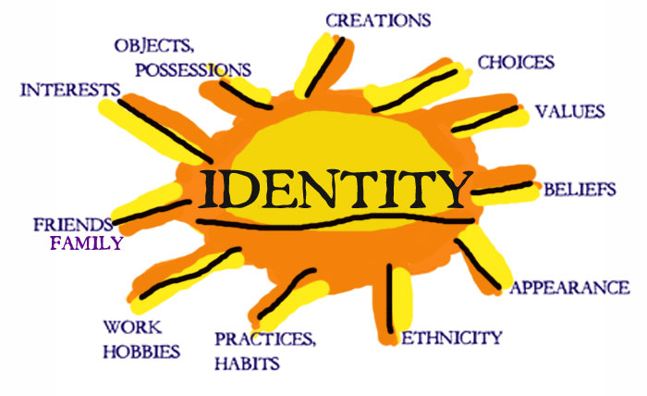
Chapter One: Globalization and Identity
Factors that shape who you are:
Family
Friends
Language
History
Role Models
Activities
Heritage

Slide 3
Chapter One: Globalization and Identity
How do you express who you are as an individual?
Traditions eg.
Language eg.
Clothing and Adornment eg.

Slide 4
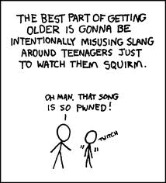
Chapter One: Globalization and Identity
How do you express who you are as a collective?
Language eg.
Slang and Jargon eg.
Context (family, school, clubs, teams, religion, friends) eg.

Slide 5
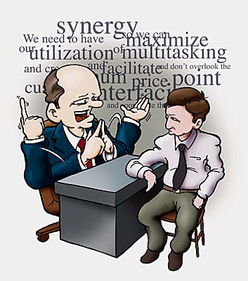
Chapter One: Globalization and Identity
Slang
Jargon

Slide 6
Chapter One: Globalization and Identity
Key Terms
Globalization: Globalization (or globalisation) describes an ongoing process by which regional economies, societies, and cultures have become integrated through a globe-spanning network of communication and trade.
Context: The circumstances or surroundings – in which your identity is developed
Role Model: A person whom others can look up to or pattern their behaviour.
Collective: A group of people with identifiable similarities

Slide 7
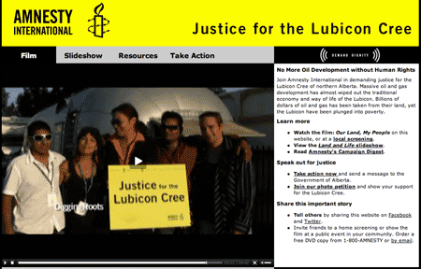
Contemporary Example
The Struggle of the Lubicon Cree to Affirm Their Identity (p. 32)

Slide 8
Chapter Two: Identity and the Forces of Globalization
Forces of Globalization
Trade – People obtain things they cannot get locally from other places or sell local things around the world. Eg.
Key Term: Transnational Corporation – a corporation that operates in more than one nation (multinational corporation)
Transportation – Essential for trade, containerization has revolutionized trade making it cheaper and easier.
Key Term Containerization – standardized shipping containers enabling global movement of goods

Slide 9
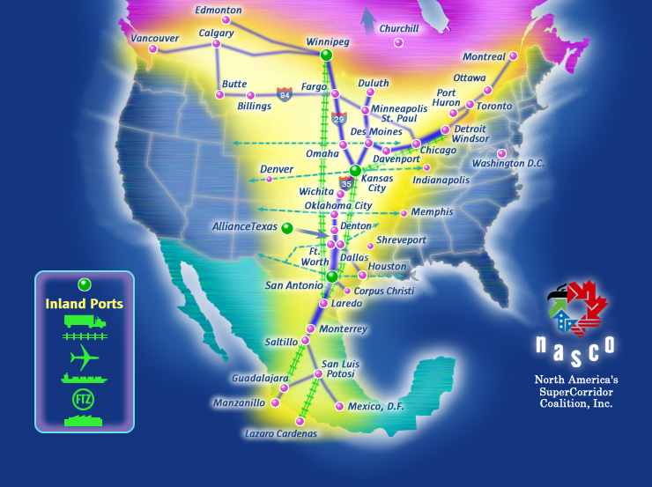

Slide 10
Chapter Two: Identity and the Forces of Globalization
Communication Technology – Advances in digital technology has revolutionized the way that information and ideas travel around the world
Media – Increased availability and affordability of various media (tv, music, movies, newspapers, internet) have a dramatic impact on peoples understanding of the world and identity.
Key Term Media Concentration – The ownership of media companies is increasingly in the hands of a few large corporations
Key Term Media Convergence – the use of electronic technology to integrate newspapers, books, tv and the internet.

Slide 11
Chapter Two: Identity and the Forces of Globalization
Dimensions of Globalization (economic, social, political, environmental)
Key Term: Economies of Scale – savings that come from producing, using, and buying things in large quantities
Key Term: WTO – (World Trade Organization) An organization of 150 countries that governs trade
Key Term: Biodiversity – variety in plant and animal species

Slide 12
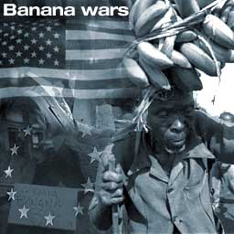
Contemporary Example
The Banana Wars (p. 50)

Slide 13
Chapter Two: Identity and the Forces of Globalization
Challenges of Globalization to identity
Homogenization – erases the differences between people making them more similar
Acculturation – the cultural changes that occur when two cultures accommodate or adapt to each other world view.
Accommodation – Accepting and making space for cultural differences
Assimilation – a minority group that is absorbed by a larger culture

Slide 14
Contemporary Example
Responses and opportunities to affirm and promote identity:
How do the Metis use the forces of globalization and dimensions of social studies to respond to the challenges of globalization?
Key Term Cultural Revitalization – the process of affirming and promoting individual and collective cultural identity

Slide 15
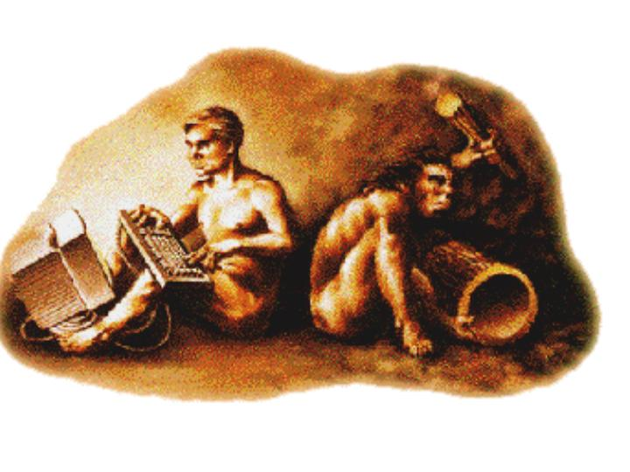
Chapter Three: Identity, the Media, and Communication Technology
Key Term: Digital Divide – the gap that separates people who have accesss to digital technology from those that do not
Key Term: Propaganda – ideas and information spread to achieve a specific goal

Slide 16
Key Idea
Marshall McLuhan – Living in the global village (p. 70)
“The medium is the message”

Slide 17
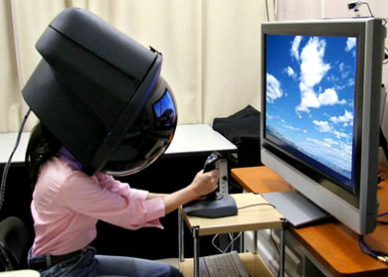
Chapter Three: Identity, the Media, and Communication Technology
Key Term: Techno-isolation – Technology allows people to pursue their own interests to the exclusion of community

Slide 18
Chapter Three: Identity, the Media, and Communication Technology
Effects of Technology on Cultural Diversity – we have looked at the effect that technology and media have on cultural diversity and or promoting cultural diversity in our critical challenge.
Key Term: Pop Culture – Popular culture or the culture of the people today
Key Term: Universalization of pop culture – global communication allows people to share pop culture trends and leads to cultural homogenization
Key Term: Hybridization – Combining elements of two cultures together

Slide 19
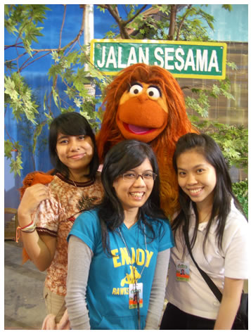
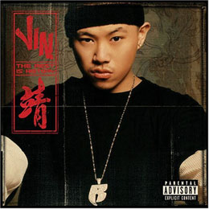
Pop Culture and Media
Hybridization
Universalization

Slide 20
Chapter Four: Affirming Identity, Language, and Culture
Affirming and Promoting Language in a globalizing world. Many people believe increased interdependence and communication will lead to greater understanding and acceptance and more common languages like english. Other people believe endangering language endangers cultural diversity – languages disappear when to few people speak them.

Slide 21
Chapter Four: Affirming Identity, Language, and Culture
How do governments affirm and promote languages and cultures in a globalizing world?
Things to review:
Cultural Content Laws:
CRTC:
Cultural Diversity:
Contemporary Examples
Endangered Languages and the dominance of English
La Francophonie
Declaration of the rights of Indigenous peoples

Slide 22
Chapter Four: Affirming Identity, Language, and Culture
How do international organizations affirm and promote languages and cultures in a globalizing world?
La Francophonie:
Declaration of the Rights of Indigenous Peoples (UN 2006):
Key term: Cultural diversity

Slide 23
Chapter 4 – “Affirming Identity, Language and Culture”
Pages 88-109
Exploring Globalization

Slide 24
Read pages 90-93
To some people Language is identity
Do you feel that way?
Experts believe that there are between 6000-7000 languages spoken on Earth.
And that about 1 language disappears each week.
However, some languages are still being discovered in remote areas.

Slide 25
Of these 6000 languages 96% are spoken by only 4% of the population.
Tevfik Esenc 1904-1992
What does that mean?
Most of the languages are endangered.
For example, ‘Ubykh’ died in 1992 when the last person able to speak it died in Russia.

Slide 26
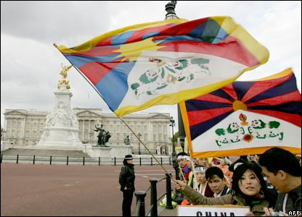
What are the top 3 languages in terms of number of speakers?
Chinese
English
Spanish

Slide 27
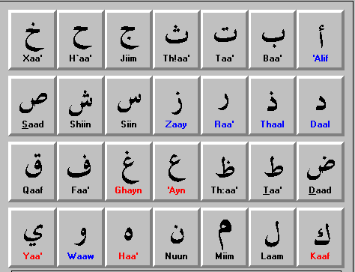
Why is English the dominant language?
It is the most common in the business, scientific research, pop culture, and the internet and World Wide Web.
The internet is designed to use the Roman alphabet (a, b, c, d….) not characters used in other languages such as Arabic, Russian, Chinese or Japanese.
What does this mean?
Most people can’t benefit from it.

Slide 28
However!
The number of people who grow up speaking English as their first language is declining!
9% of the world population now speaks English as their first language and it is expected to drop to 5% in 2050.
In 2006 what was the world’s largest language group, in terms of first language speakers?
Mandarin Chinese.

Slide 29
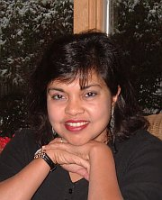
Read ‘Magic Carpet’ page 93- Exploring Globalization
Discuss ‘Reflect and Respond’ on page 93- Exploring Globalization.

Slide 30
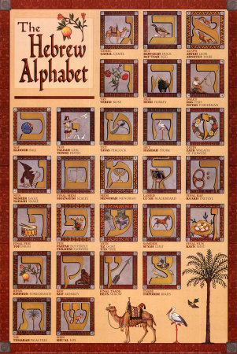
Can languages be saved from extinction?
The Hebrew language.
In 1880 no child spoke it as their first language. It was a sacred language, used for prayer and recitation. Today after many years of determination by the Jewish people to revitalize and modernize the language, it is the Official language of Israel. By 1995, 63% of the population spoke Hebrew as their first language.

Slide 31
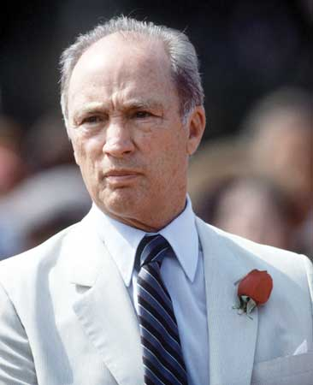
Canada was the first country in the world to adopt Multiculturalism as official government policy!
Pierre Elliot Trudeau was the Prime Minister at the time.
In 2006, on Multiculturalism Day, our Governor General Michelle Jean (Born in Haiti) reaffirmed the policy by saying…

Slide 32
“Today’s Canada contains the world. Rich in demographic and cultural diversity, Canada is a model of openness and harmony in the concert of nations… Bringing together so many cultures and perspectives certainly enriches us all, but it is also a challenge that all of humanity must now face in this age of globalization… Together, let us build on the strengths of our diversity and on dialogue rather than become mired in the clash of cultures.”

Slide 33
Other programs, policies and laws that protect and promote language and culture in Canada are
Official Languages Act of 1969, English and French are the country’s official languages.
Charter of Rights and Freedoms of 1982.
Cultural Content Laws, to protect artists, performers, songs, movies and literature. In 1968 the CRTC (Canadian Radio-Television and Telecommunications Commission) enforced quotas for Canadian content; 30% of music and 60% of Television must be Canadian.
France, Australia, China, and Mexico all have similar policies to protect their language and culture.

Slide 34
UNESCO, which includes 191 member states, is one of the largest international organizations promoting Cultural Diversity. Their motto is ‘Cultural wealth of the world is its diversity in dialogue’.
How globalization is helping or hurting cultural diversity.
How do you protect intangible history such as carnival’s, songs, stories, theatre pieces, teachings and celebrations?

Slide 35
UNESCO, which includes 191 member states, is one of the largest international organizations promoting Cultural Diversity. Their motto is ‘Cultural wealth of the world is its diversity in dialogue’.
How globalization is helping or hurting cultural diversity.
How do you protect intangible history such as carnival’s, songs, stories, theatre pieces, teachings and celebrations?

Slide 36
In 2006 Indigenous people from around the world wanted the United Nations General Assembly to adopt the ‘Declaration on the Rights of Indigenous People’ it was delayed and is still in discussion as some nations including Canada did not agree with the wording of the declaration.

