Slide 1
Related Issue 1: To what extent should we embrace Nationalism?
Chapter 3: Reconciling Nationalist Loyalties

Slide 2
Specific Outcome 1.10/Chapter 3
Analyze the importance of reconciling contending nationalist loyalties (Canadian nationalism, First Nations and Metis nationalism, ethnic nationalism in Canada, Quebecois nationalism, Inuit perspectives on nationalism

Slide 3
Loyalties
Loyalty means to be firmly committed or faithful to someone or something.
Patriotism is the love of one’s country or nation: a section of Highway 401 was renamed the Highway of Heroes to honor soldiers who have died in Afghanistan
A nationalist loyalty means to be faithful
to your country or nation: going to a
parade, or displaying a flag, or keeping
in touch with your community.

Slide 4
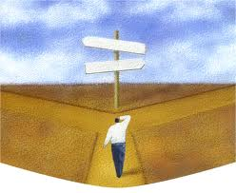
Contending loyalties
Contending means struggling or competing
Sometimes you have to choose between loyalties: you may have been invited to a friend’s on the same day that your family has planned an outing.

Slide 5
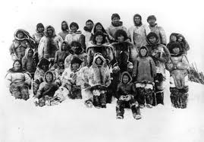
Reclaiming Inuit names
Names can affirm nationalist loyalties
When Europeans first arrived in the Canadian Arctic, they ignored Inuit names and gave English or French names, such as Frobisher Bay.
The Inuit are now reclaiming
many of their own place
names: Frobisher Bay was
renamed Iqaluit, which
means ‘place of fish’.

Slide 6
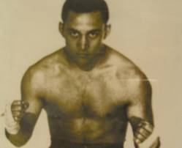
Inuit names and identity
Traditionally, Inuit had only one name.
The Canadian government thought that made it hard to keep track of people, so it assigned a personal number to each Inuk.
Some teachers would use those numbers instead of names
Watch the video: Kiviaq versus Canada (on my webpage)

Slide 7
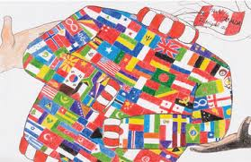
National loyalties in a pluralistic society
Cultural pluralism: more than one culture; people from many nations living together in harmony
Canadians are encouraged to honor their cultural heritage, and laws make sure they can.
Some people disagree: “How far is too far?”

Slide 8
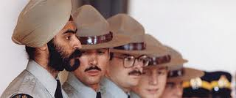
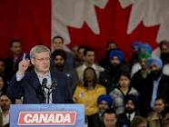
Expressing non-Canadian nationalist loyalties
Reasonable accommodation: Canadian institutions must adapt to the religious and cultural practices of minorities as long as those practices do not violate other rights and freedoms.
For example, the RCMP allows officers of the Sikh faith to wear a turban and to not shave, which are elements of their religious beliefs

Slide 9
Reasonable accommodation in Québec
Québec, as a French province, tries to keep is French identity, and struggles with how to accommodate minorities who want to keep their own identity.
Example of a lack of accommodation:
Women wearing a burka cannot be served at a government office.
Asmahan Mansour was told she couldn’t play soccer wearing a hijab.

Slide 10
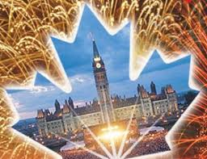
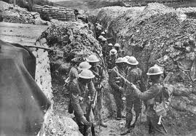
How can nationalist loyalties create conflict?
July 1st in Newfoundland
July 1st in the rest of Canada
The anniversary of a WW1 battle that killed 780 soldiers of the Newfoundland Regiment
A big party!

Slide 11
Contending loyalties in Quebec
In Quebec, some people known as sovereignists would like for Quebec to become a country, while others known as federalists would like for Quebec to remain a province of Canada.
In 1995, Quebec had a referendum (a vote) about whether or not to remain in Canada: 50.2% of people voted to stay with Canada

Slide 12
Quebecois Nationalism read page 78 & 79
 | Details…. | Impact
Boost the Birthrate
Left Behind
Ready for Change
Bill 101 and Quebec Anglophones
Bill 101 and Quebec Francophones

Slide 13
How have people dealt with competing nationalist loyalties?
An example of conflict: Oka
Quick facts:
The town of Oka in Quebec wanted to expand a golf course.
The Mohawks claimed the land in question was an ancestral burial ground and set up a roadblock
Quebec’s police force was called in to settle the dispute, shots were fired and a police officer was killed.
The Canadian army was called in and eventually put an end to the dispute.

Slide 14
Reconciliation
Reconciling can mean coming to terms with the past or mending a broken relationship
When people or nations disagree or when their nationalist loyalties lead them to pursue contending goals, reconciliation can bring them together and help them live together in peace.

Slide 15
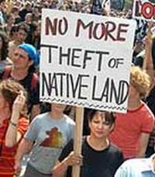
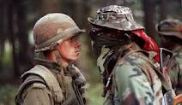
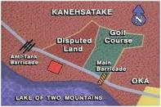
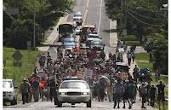

Slide 16
Watch the Oka Crisis Video…
What was the crisis over initially (in the beginning) ____________________________________________________________________________________________________________________________________________
What did the Oka Crisis come to represent ___________________________________________________________________________________________________________________________________________________________________________________________________________________________________________

Slide 17
The Royal Commission on Aboriginal Peoples
The federal government called this commission because of the Oka crisis.
The commission visited many communities and talked to many people.
The report written by the commission condemned the treatment of Aboriginal peoples, and urged Canadians to view First Nation, Inuit and Metis as nations with a right to govern themselves.

Slide 18
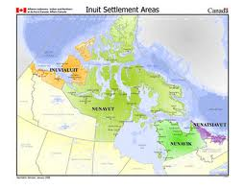
Land claims
A land claim is an Aboriginal people’s claim to the right to control the land where they traditionally lived
The land claim process is slow: The James Bay Agreement started in 1971 and wasn’t settled until 2008

Slide 19
The View From Here
Read p. 85 and answer the three Explorations questions

