Slide 1
Related Issue #1
To what extent are nation and identity related?

Slide 2
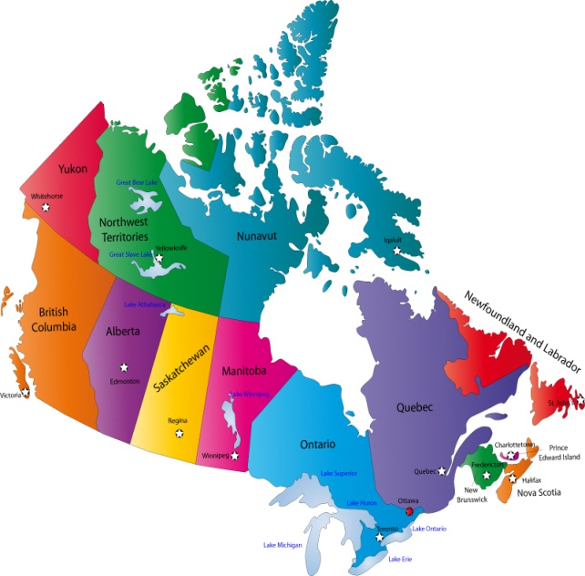
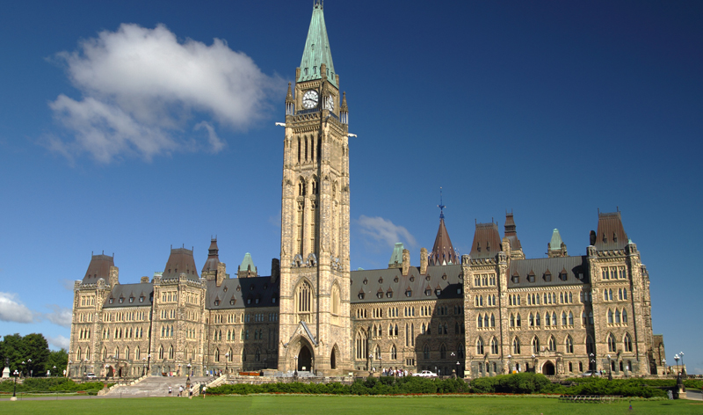
Chapter 1 – Nation and Identity
What are Some Concepts of Nation?
Nation means different things to different people
Nation to some means Country – a distinct physical territory with a government

Slide 3
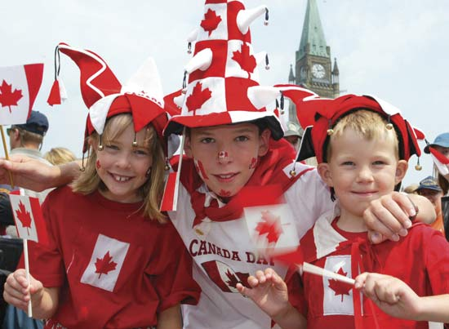
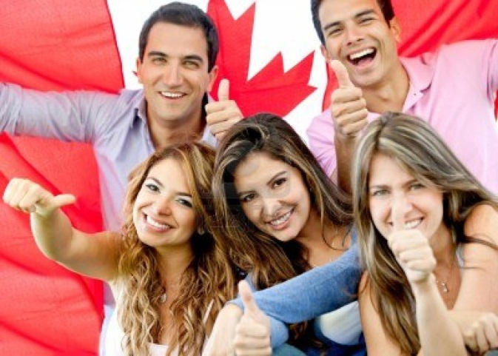
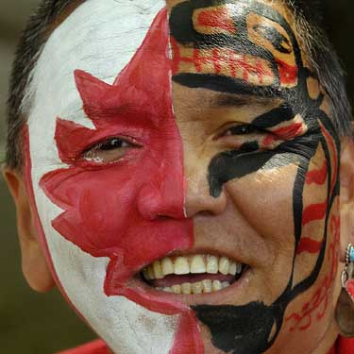
Others see nation as the people who share a sense of belonging together

Slide 4
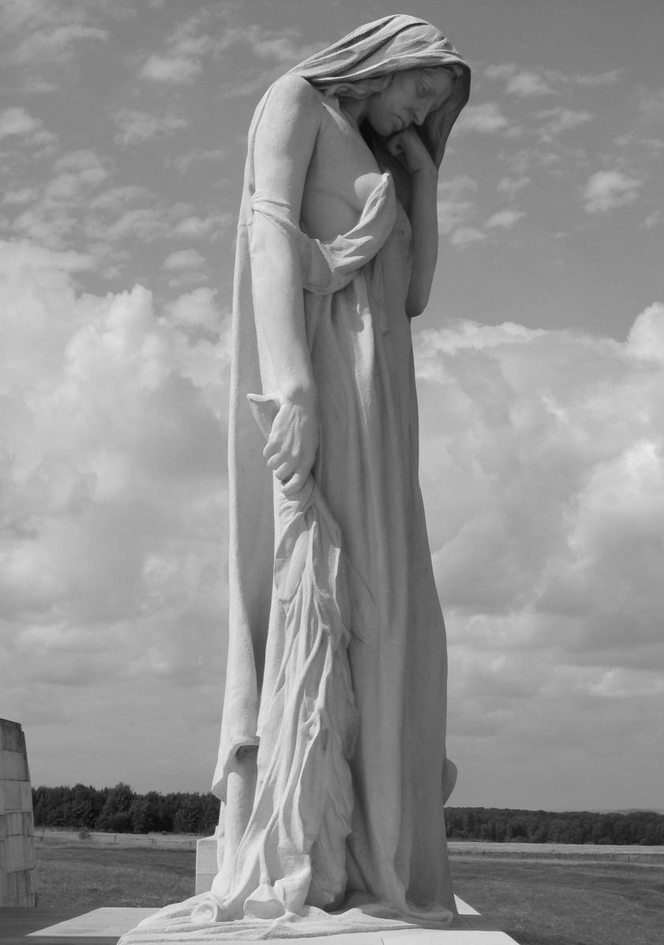
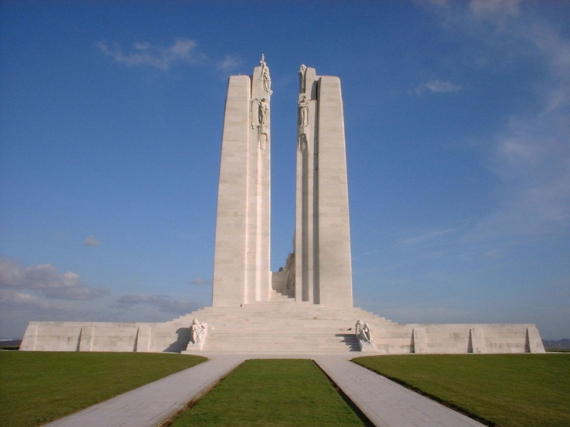
Nation and Us
Some People believe that when a people begin to think of themselves as ‘us’ they become a nation…eg. Vimy Ridge

Slide 5
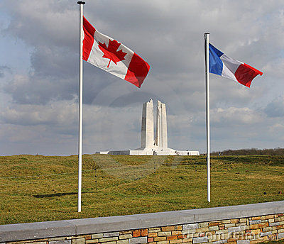
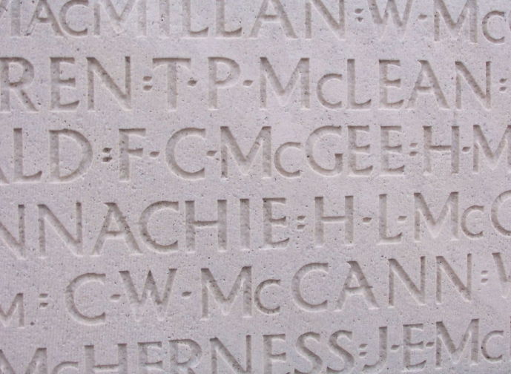
“Every nation has a creation story”
Harper addressed 15000 people at the Canadian National Vimy Memorial in France…2007 90 year celebration.

Slide 6
Country and Nation
Sometimes words are used to mean the same thing:
Nation-state means ‘country
International means ‘between countries or nation-states

Slide 7
Nation or Country?
Nation
People having a sense of belonging together
Control own destiny
May not have official borders or gov’t
Latin word meaning people or race
Country
Geographic area defined by official borders
Officially the world has over 190 official countries
Recognized by other countries

Slide 8
Page 22 - The View From Here
How does each speaker define nation?
Johann Gottlieb Fichte______________________________________
Ernest Renan______________________________________
Benedict Anderson___________________________________
Clement Chartier____________________________________

Slide 9
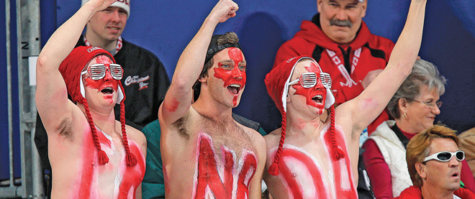
Patriotism and Nation
Patriotism – love of their country or nation.
Read Attachment #1: Canadians More willing to display patriotism, survey finds.

Slide 10
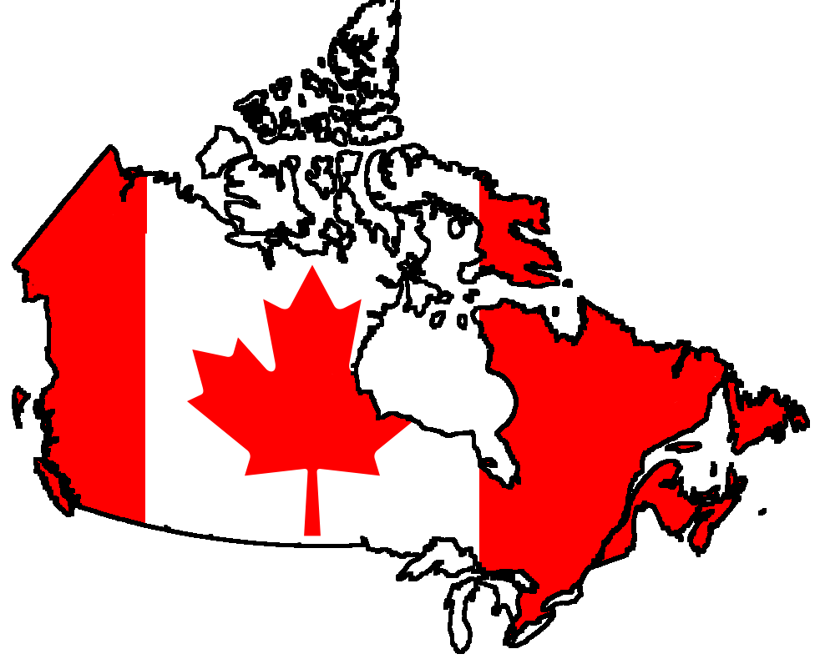
Understandings of Nation
Many believe ‘nation’ refers to people who share ideas about themselves.
These collective ideas come from a variety of sources….understandings of Nation!

Slide 11
Understandings of Nation Chart -Use pages 25-29 to complete chart – attachment #2
Understanding | Text Description | Example
Linguistic
2. Ethnic
3. Cultural
4. Religious
5. Geographic
6. Relationship to Land
7. Spiritual
8. Political

Slide 12
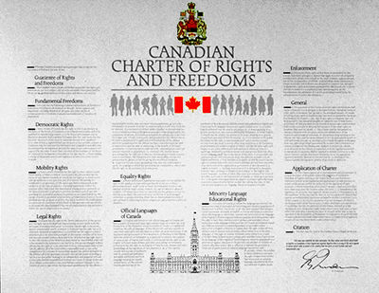
Civic Nation
Means related to citizens
Based on shared values and beliefs
Citizens are equal – have the same rights and responsibilities
Differences in language, ethnicity, culture, and religion do not matter.
Most civic nations have a constitution – legal set of rules or laws.

Slide 13
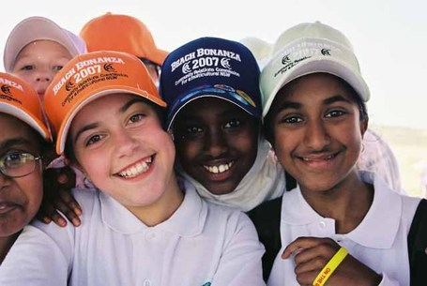
Ethnic Nation
Ethnic nationalism suggests pre-existing characteristics or traditions lead to a shared sense of nation
The people may then create a nation-state if they choose to live together with others who share their sense of nation.

Slide 14
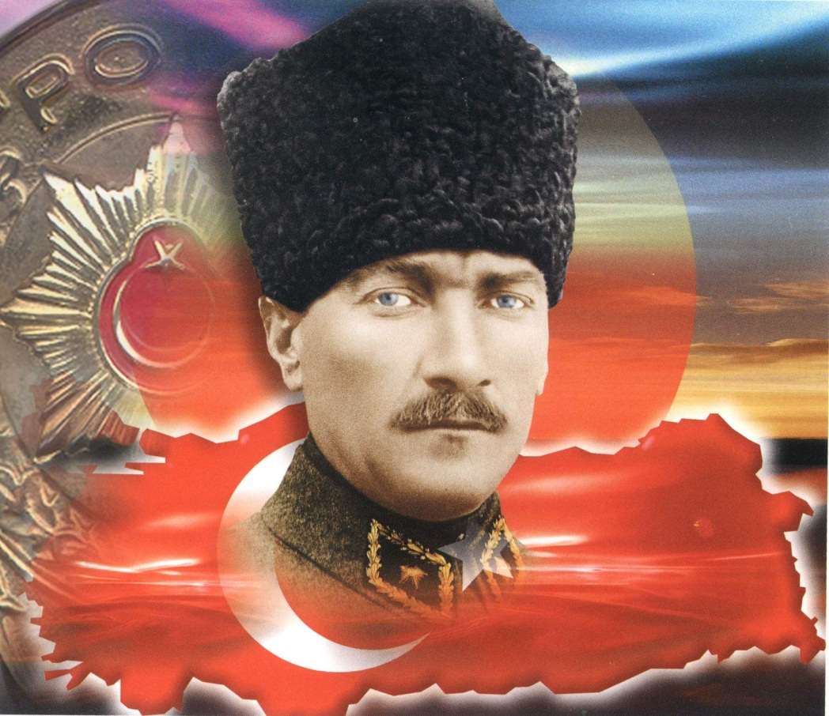
Mustafa Kemal Atuturk Founder of the Turkish Nation
Read page 33
Complete questions 1 and 2
Discuss as a class

Slide 15
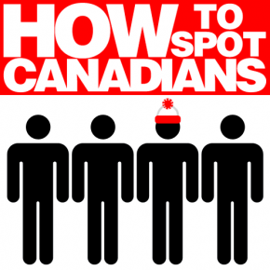
National Identity and Self
The desire to belong is one of the strongest desires a human being can feel.
The idea of nation has the power to spark feelings of belonging to a much larger collective.
When people feel this way, they have a sense of national identity.

Slide 16
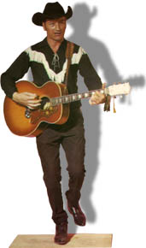
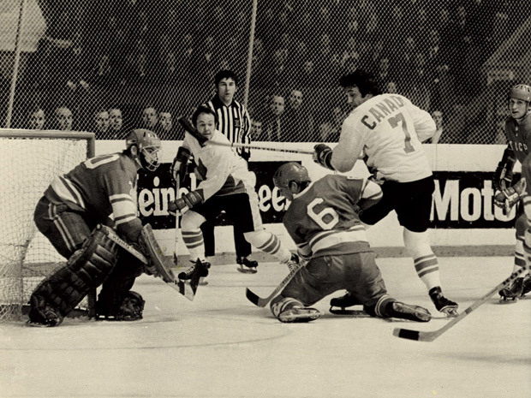
How Stories Shape a Sense of Nation
National myths –shared stories, ideas, and beliefs that may or may not be accurate – help create a sense of nation.
Often these shared stories connect people to their past, and shape how people look at the world.

