Slide 1

Social Studies 30-2
Understandings of
IDE LOGIES

Slide 2
Key Issue: To What Extent Should We Embrace an Ideology?
Related Issue 1
Should Ideology Be The Foundation of Identity?

Slide 3

Ideology
A system of thought based on beliefs & values.

Slide 4
Ideologies
What do YOU believe in?

Slide 5

What is the meaning of life?
Why do we exist?
What are humans like (nature of humans)?
What is the nature of society?
What is the role of individuals in society?
Where do I fit?

Slide 6
Characteristics of Ideology
All ideologies contain a set of beliefs and values about similar things. They are all concerned with the essential questions of life, such as:
  What are humans like and why do they act as they do?
  How should society be structured?
  How has the world worked in the past?
  How should it work in the future?

Slide 7
Where do you fit?
Take the survey on page 7.
How would you respond to the question on page 8. “If my county needs me, should I sacrifice my life in a war?”
Page 9 ~ Where do you fit in the spectrum?
Notes:
Note: have the students form a human spectrum at the front of the class

Slide 8
2 primary ideologies
Individualist – you are the most important entity - everyone for themselves, survival of the fittest
Collectivist – the group takes priority over the individual -work together for the good of all
There is no “I” in team! Collectivist
But there is an “M” and “E” and that’s ME! Individualist
Definitions on the next slides

Slide 9
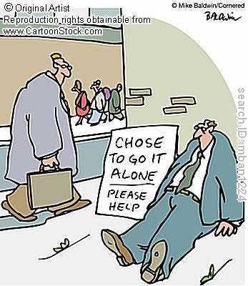
Individualism
A current of thinking that values the freedom and worth of the individual, sometimes over the security and harmony of the group.

Slide 10
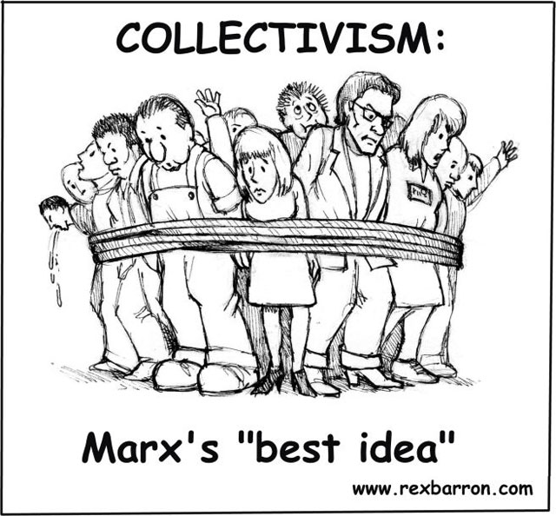
Collectivism
A current of thinking that values the goals of the group and the common good over the goals of any one individual.

Slide 11
What factors influence beliefs & values?
Culture
Language
Religion & Spiritually
Environment & relationship to the land
Gender
Media
Ideology
Answer the question on page 20
Voices
Notes:
Pages 10-19

Slide 12
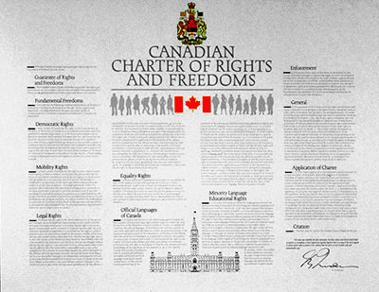
Beliefs & Values reflected in the Canadian Constitution
In the Constitution Act
In the Canadian Charter of Rights & Freedoms

Slide 13
Balancing Beliefs & Values
Look at Fig 1-4
How do these factors influence your beliefs & values?
Who or what has been the greatest influence in your life so far?
How has this affected your identity?

Slide 14
Understanding Ideologies

Slide 15
1. Themes of Ideology-define
Nation-
Religion-
Class-
Relationship to the Land & Environment-

Slide 16
Characteristics of an ideology
Text pg 39– chart
Read pages 28-38 and summarize the viewpoints on each of the following:
  Interpretations of history
  Beliefs about human nature
  Beliefs about society
  Visions of the future
  Can use a chart, web or point form notes

Slide 17
The Nature of Human Beings
Those who believe that people are basically good must, of course, find an explanation for crime and war and the other evils of the world. They explain it by the weakness of people, whose basic goodness can all too easily be suppressed by bad upbringing, wrong education, or harmful society. Those who believe people are bad expect the world to be ridden with evils and expect the achievement of anything good to be a struggle against human nature Powrie, T. (1983) “Political and Economic Systems.” Ontario: Academic Press

Slide 18
Political and Economic Spectrums

Slide 19
Political and Economic Spectrums
http://www.blackgold.ab.ca/ict/Division4/Social/Political%20Spectrum/index.htm
Political freedom
Liberal, socialist
Democratic socialist
Consrv.
Democratic capitalist
Fascist
Dictatorial capitalist
Dictatorial socialist
Comm.
Economic control
Economic freedom
Revolutionary Reationary
Political control

Slide 20
Hmmm…something to think about
Thinking about what we have just discussed, answer the following:
  What is your ideology? Complete the questions on page 7 to determine your ideology.
  What are your opinions of what we have discussed?
  Do you think your opinions might change, or are you positive in your position
  What are some questions that are still unanswered?

Slide 21
Role of the individual
The key issue in determining the degree to which an ideology is individualist or collectivist is the understanding of what the individual’s role is in that society
  Individualist – self-reliance, freedom from authority
    Example: private business (succeed or fail)
  Collectivist – interdependence, importance of the group over the individual
    Example: universal health care (all pay the same regardless of use)

Slide 22
Historical Understandings
Cave Man: collective – could only survive by working with the group; identity based on group membership
Early Christians – had all things in common
Aboriginal societies – Potlatch on the West Coast

Slide 23
Evolution of individualism in Western society
Medieval Times – (later Middle Ages) people identified with their group (clergy, peasant, craftsman) rather than their individual identity; authority came from God = little room for individualism in political matters
Renaissance – greater interest in the individual (revival of Greek and Roman attitudes); humanistic art (taking credit for works)
Protestant Reformation – individual challenges to the Catholic Church (religion became more personal)

Slide 24
Historical understanding

Slide 25
Government control is seen as interfering and counter-productive
Individualism
rule of law
individual rights and freedoms
economic freedom
self-interest
competition
private property

Slide 26
Individualism
Text pages 71 - 79
Rule of law – everyone is subject to the law, including the government – each individual is the same
Individual Rights – key to liberalism is for each individual to have the right to vote, freedom of conscience, association…
  Balance of individual rights – freedom of speech
Private Property – real estate, physical property and intellectual property: respecting the individual
Self-interest/economic freedom: laissez-faire and invisible hand

Slide 27
Government is seen as a positive force that can help by controlling society
Collectivism
economic equality
co-operation
public property
collective interest
collective responsibility
adherence to collective norms

Slide 28
Collectivism
Text pages 80 - 86
Economic equality – may not mean same amount of money, but access to goods and services
  Progressive taxation
Public property (owned by the state) – in the interest of the collective society
Collective interest – unions
Collective responsibility – holding the whole group responsible for the actions of individuals within the group (connections)
Collective norms – often voluntary, but the ideological pressure encourages people to follow

Slide 29
Textbook Reading
Read pages 88 – 91, 94 – 97 and make your own notes of how to identify if someone’s actions are individualist or collectivist.
  E.g
Then compare your notes with a classmates to see if you agree on your criteria.
Debates:
  Pg 76 – intellectual property rights discussion
  Pg 92 – child care debate
  Pg 98 – smoking laws
Actions of an individualist | Actions of a collectivist

Slide 30
Where do you fit in?
Check out this survey online…
The Political Compass

Slide 31
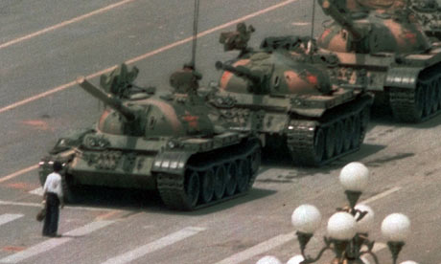
CONFLICT OConflicting Ideologies
Research Tiananmen Square Massacre and explain how this was
an example of conflicting Ideologies.

