Slide 1
2.9 – analyze ideological systems that rejected liberalism
Chapter 7

Slide 2
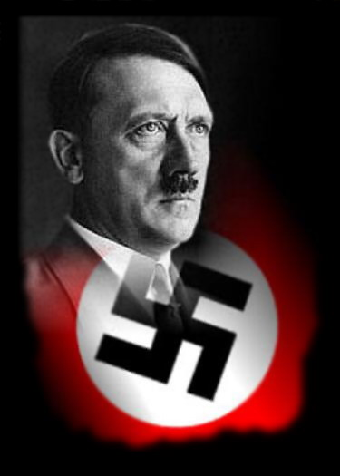
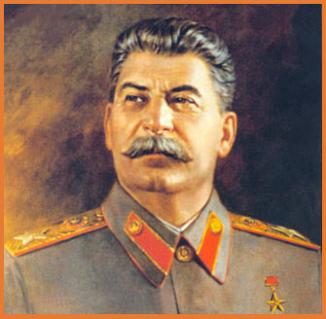
The rejection of liberalism
We have talked about modern liberalism and socialism as responses to classical liberalism. They were not the only responses – the values of liberalism were rejected by the Soviet Union and Nazi Germany between WWI and WWII as they promoted communism and fascism

Slide 3
Your task:
In your assigned groups, you will research your topic you have been given. You will need to analyze your topic as it relates to the rejection of liberalism.

